Slide 1
Potential for water buffering A landscape based approach
Lieselotte Tolk, et al.
www.acaciawater.com

Slide 2
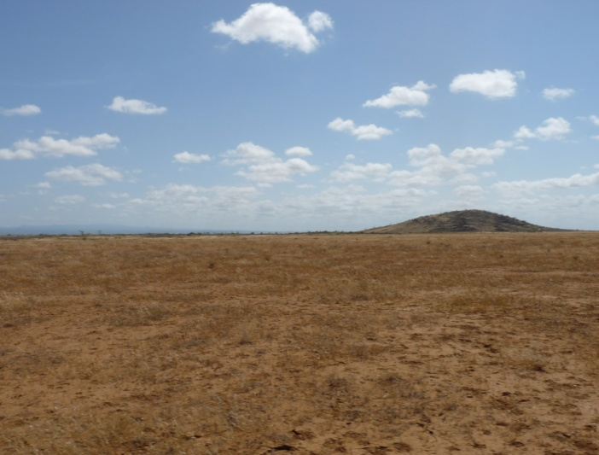
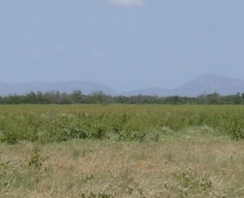
Goal: identify 3R options to buffer water
based on the characteristics of the landscape

Slide 3
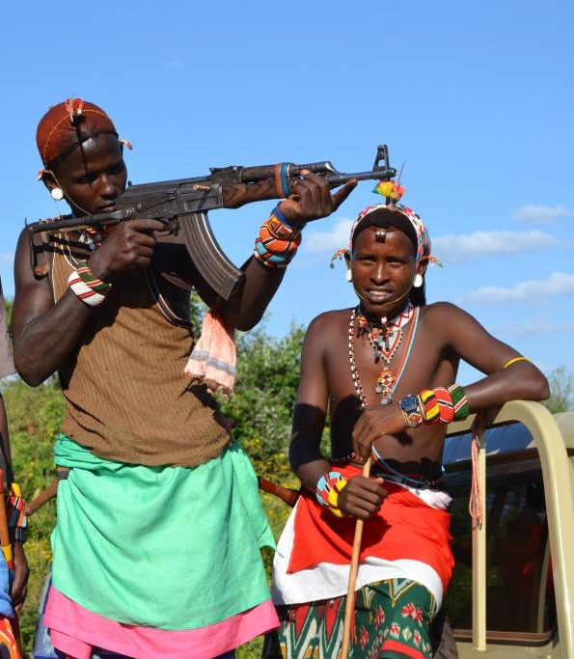
Characteristics of suitable 3R options
Area specific, incorporating the possibilities and limitation of the physical landscape
Local demand driven, fitting in the socio-economic landscape of the specific area
R I
D A

Slide 4
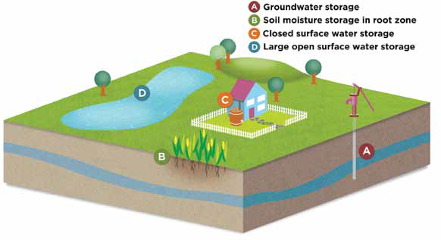
Various options for water storage

Slide 5
What fits where in the landscape?

Slide 6
Depends on the landscape characteristics
E.g.
Geological formations
Elevation and topography
Soil characteristics
Flow accumulation
Impermeable and permeable layers in the subsurface
Infiltration rates
Sediment in the riverbeds
Depth of the hardrock

Slide 7
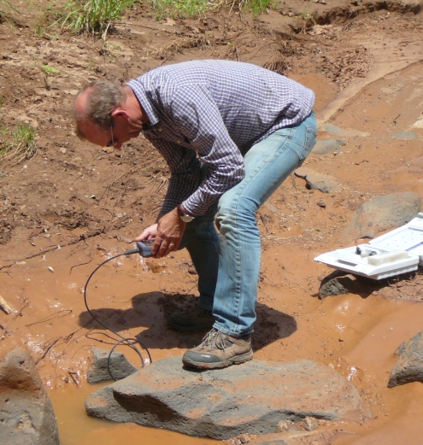
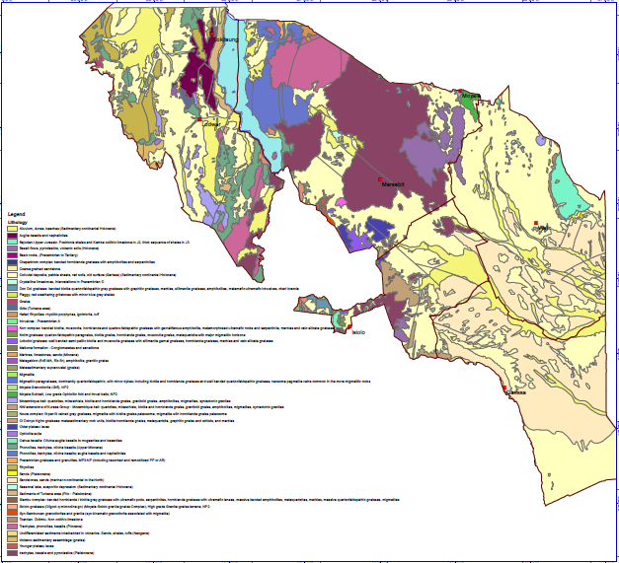
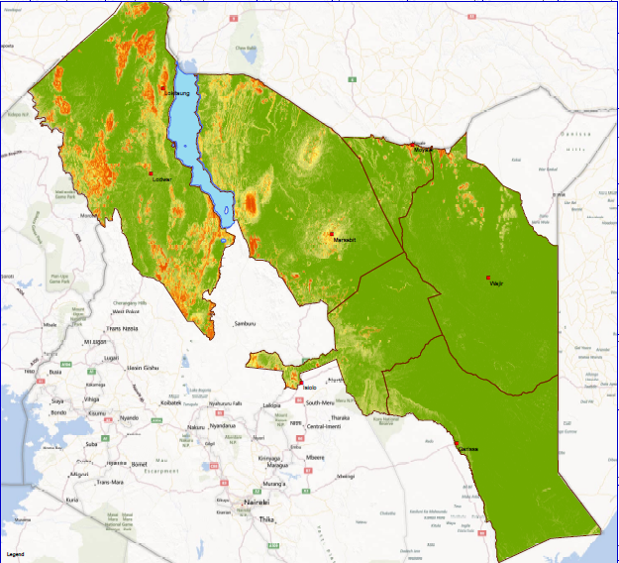
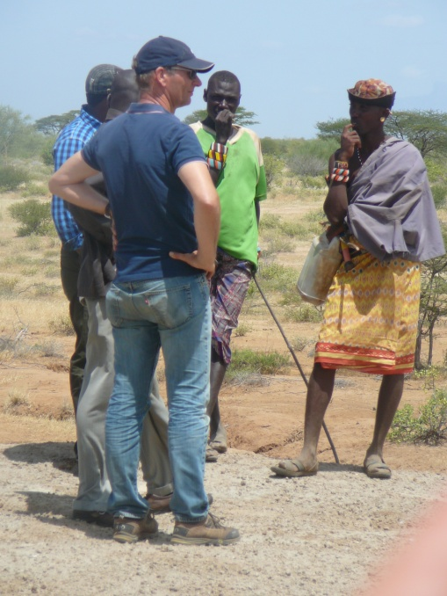
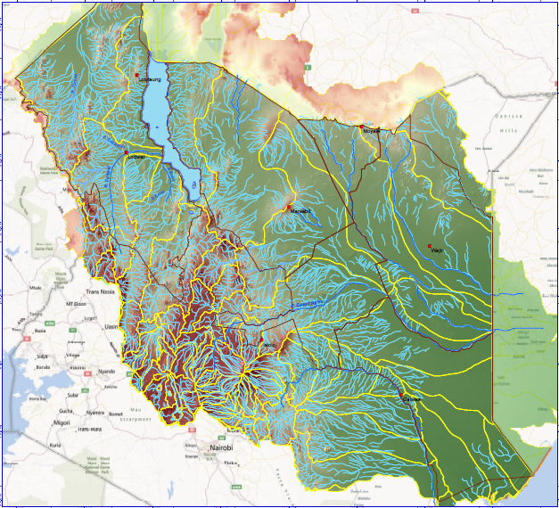
Analysis of the various information sources

Slide 8
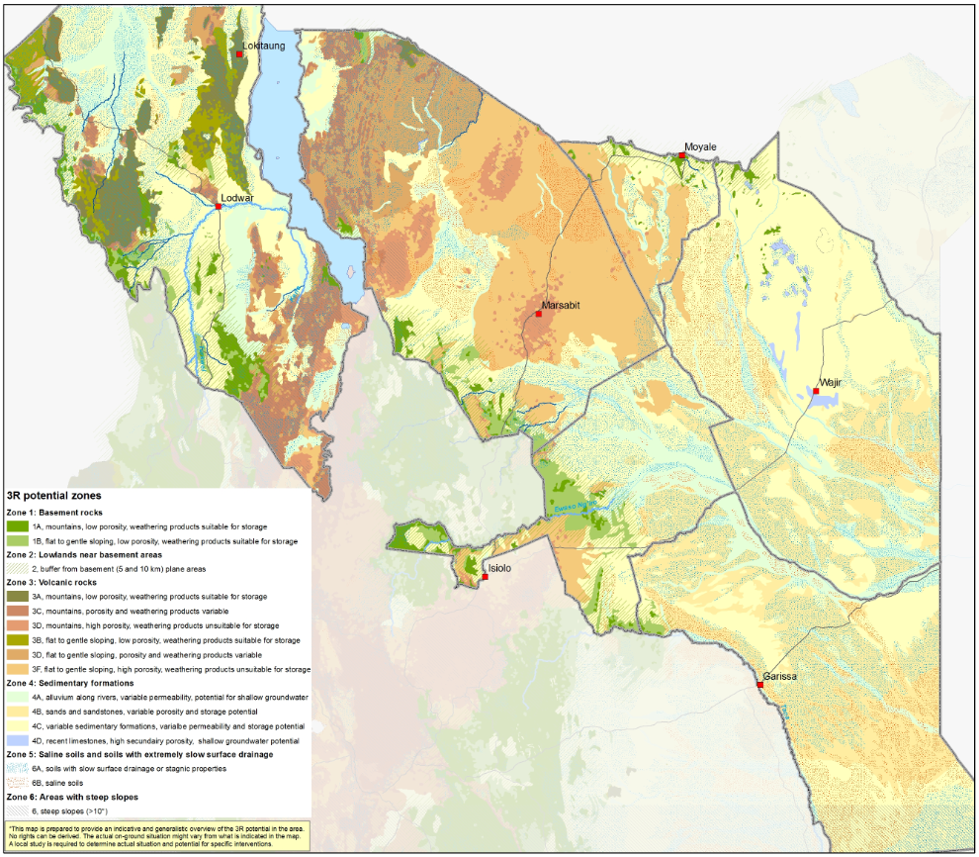
What fits where in the Northern Kenya
Shallow groundwater potential
Subsurface dam potential
Cost effective water pan potential
Sanddam potential

Slide 9
Ways to use the 3R map
Inspiration for interventions in addition to those currently applied in an area
Indicate possible target regions to apply specific kinds of interventions
As a base to work on an area integrated view, e.g. to connect examples in different areas
overall: as an inspirational / planning / evaluation tool for the feasibility phase

Slide 10
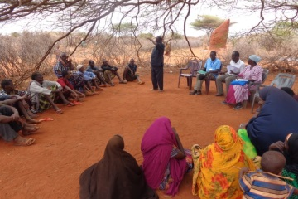
Informed decision making
Dialogue based on locally known possibilities
=> Becomes dialogue based on the broader possibilities

Slide 11
The landscape based approach can be beneficial for
Implementing organizations:
framework to determining the options for interventions to implement
an indication of the options to consider in an area in Northern Kenya when applying for funding
Policy makers and coordinating bodies:
evaluate and advice on planning of implementing organization
Funding organizations:
indicate different options to provide funding for
provide an example of a feasibility phase which could be beneficial as a part of project calls

Slide 12
Summarizing
Zones with various characteristics are identified in Northern Kenya, each with its own 3R potential
This provides inspiration to export good practices from one area to another
The 3R potential map provides guidance for implementing organizations, policy makers, coordinating bodies, and funding organizations
General data should be complemented with local, site specific information before implementation
The approach developed for Northern Kenya is applicable for various regions

Slide 13
SOMETIMES YOU ARE STANDING
ON A SOLUTION
WITHOUT KNOWING IT

