Slide 1
3R in Kenya
Notes from Kitui and Kajiado on sustainable water development technology

Slide 2
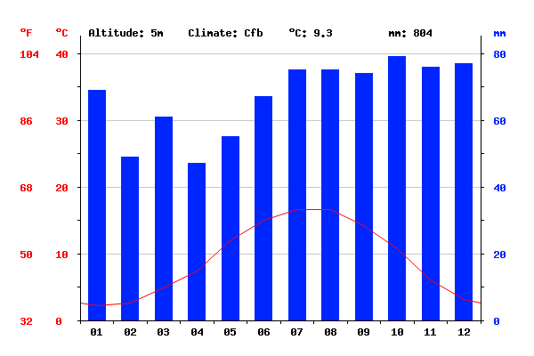
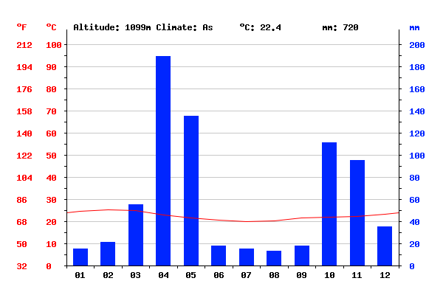
Rainfall, Netherlands vs Kenya
Utrecht
Annual precipitation 804 mm
Max. per month 80 mm
Min. per month 25 mm
Kitui
Annual precipitation 720 mm
Max. per month 190 mm
Min. per month 10

Slide 3
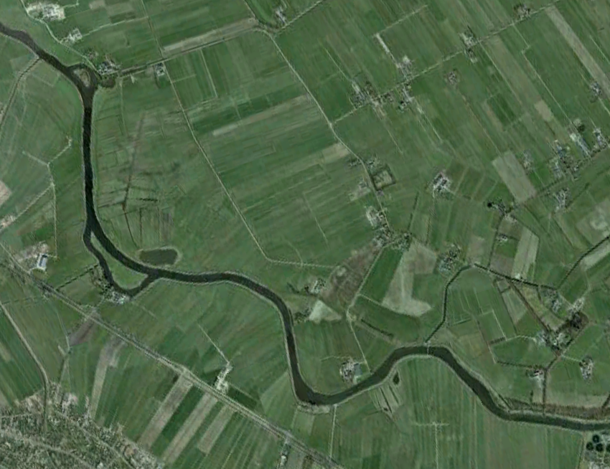
Water in Utrecht, Netherlands

Slide 4
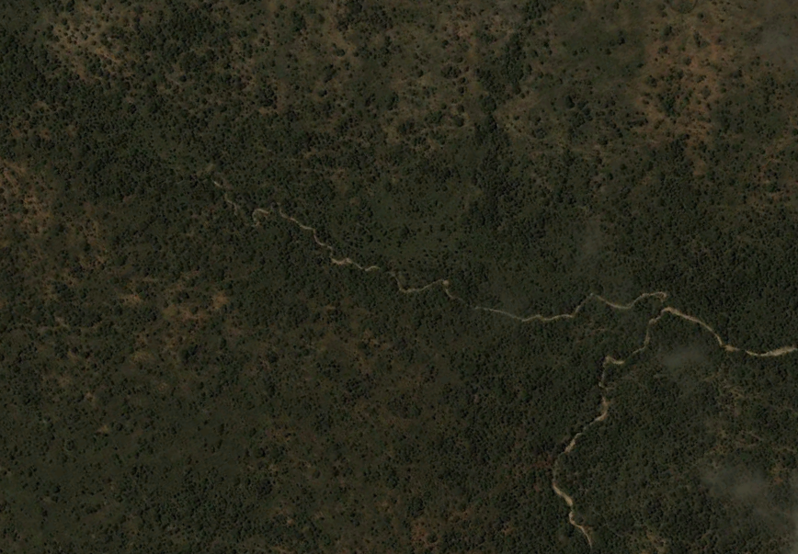
Water in Kajiado Kenya

Slide 5
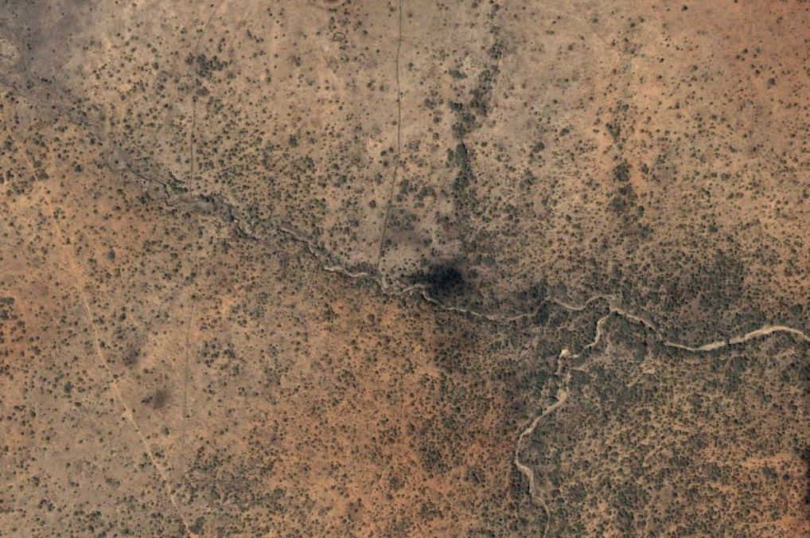
And again Kajiado, but now in the dry season

Slide 6
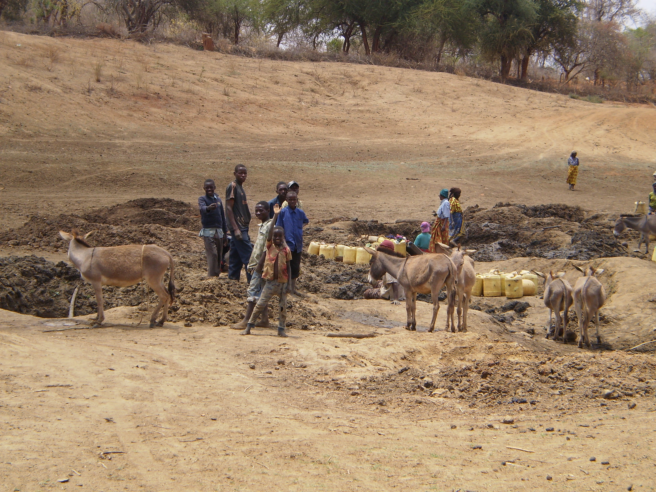
How do people get water

Slide 7
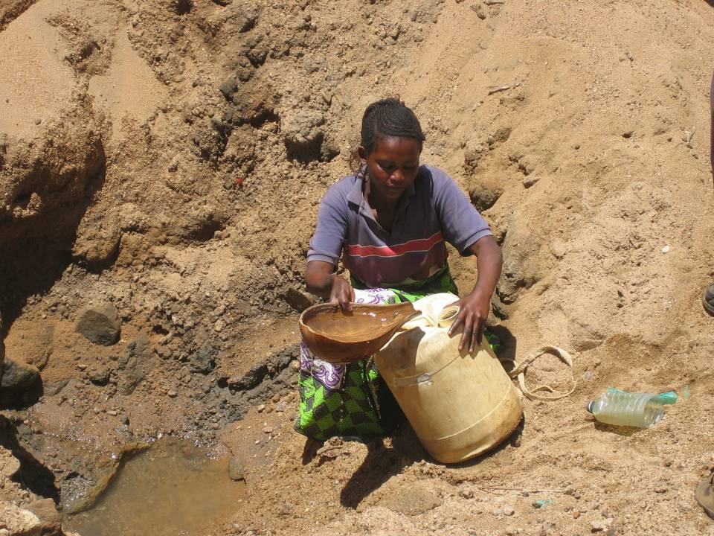

Slide 8
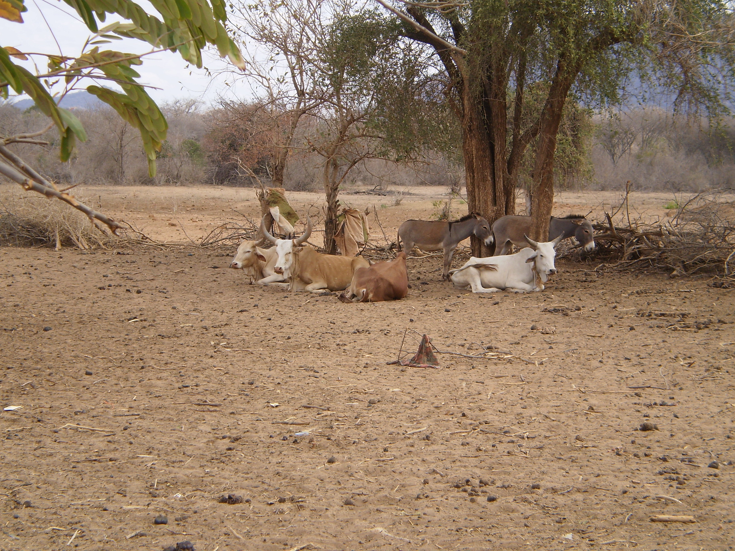
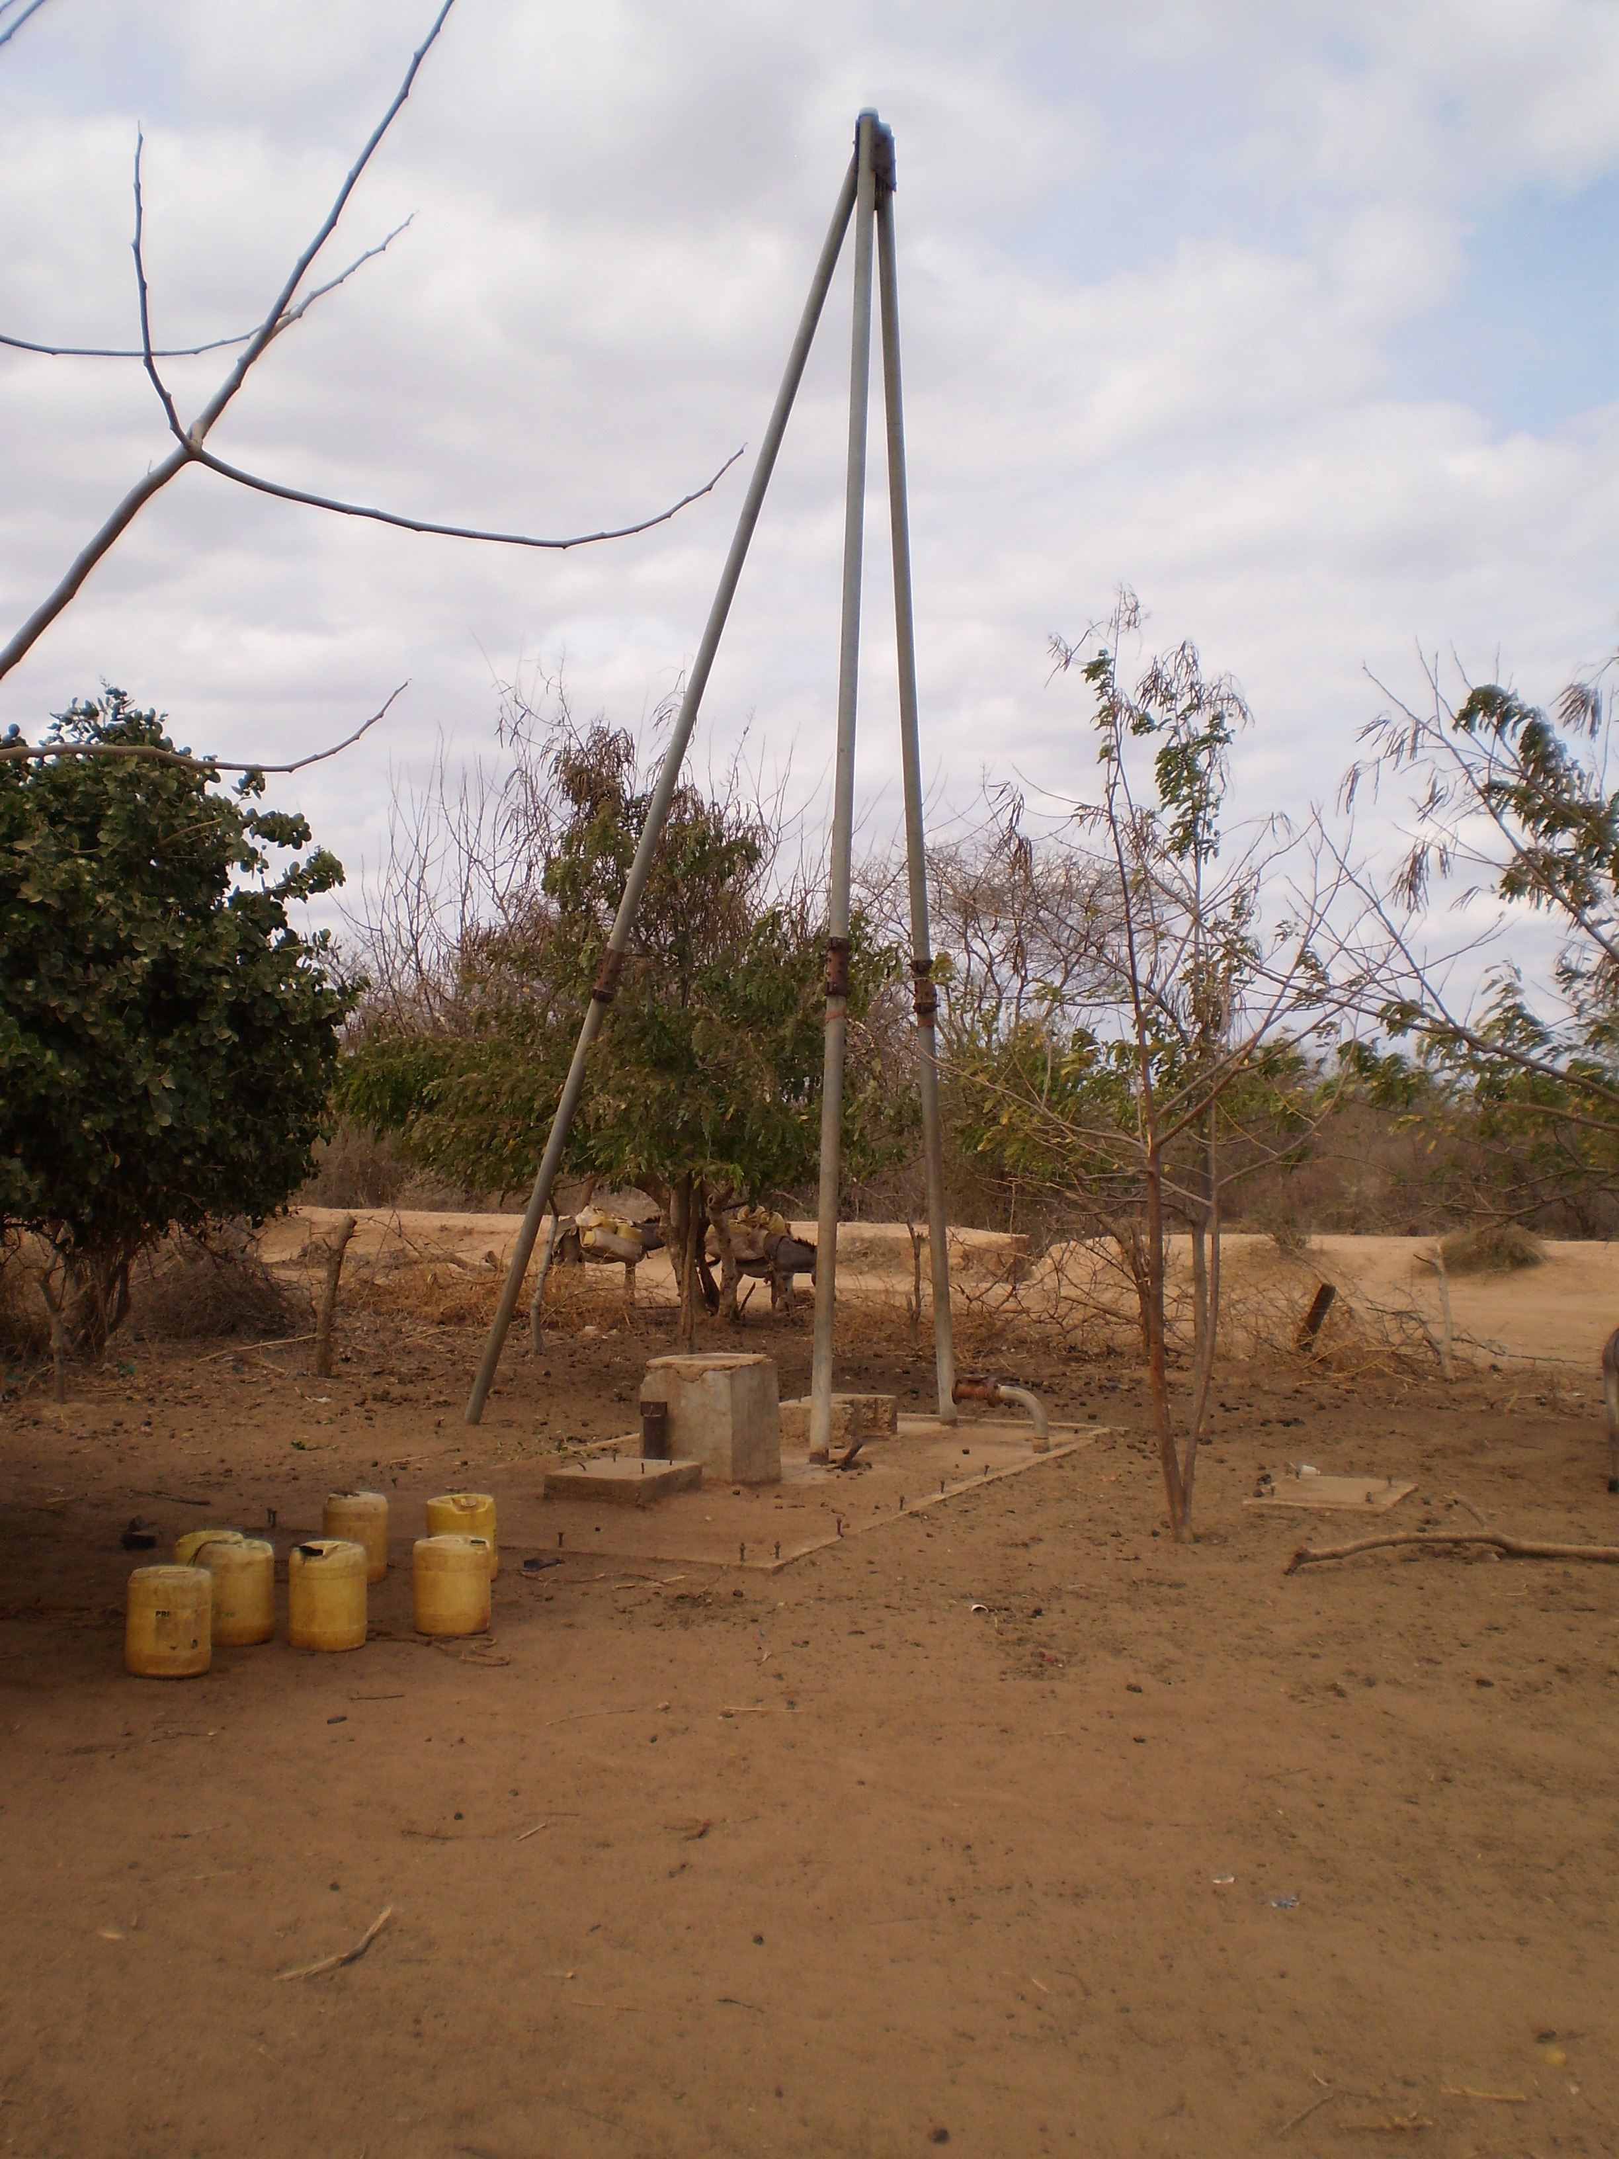
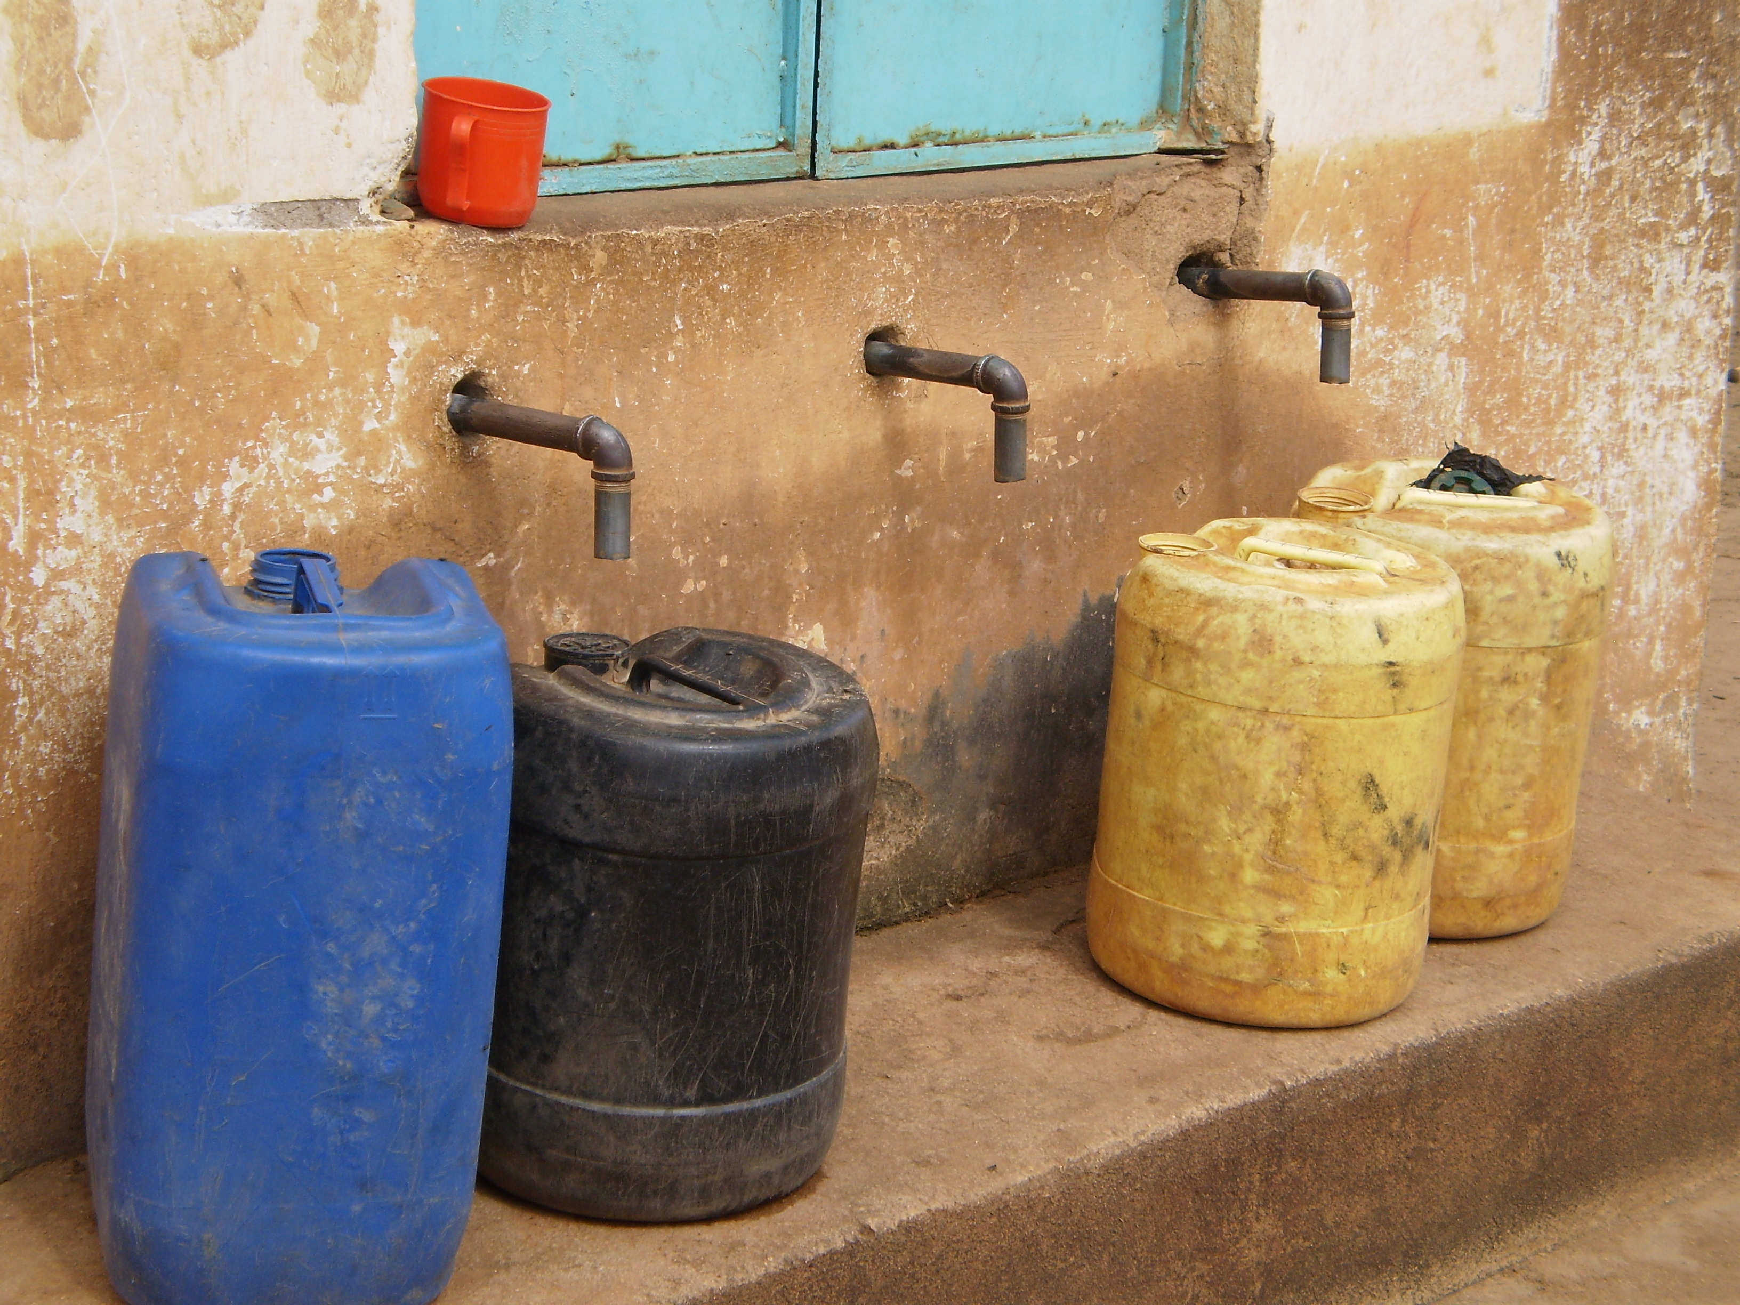
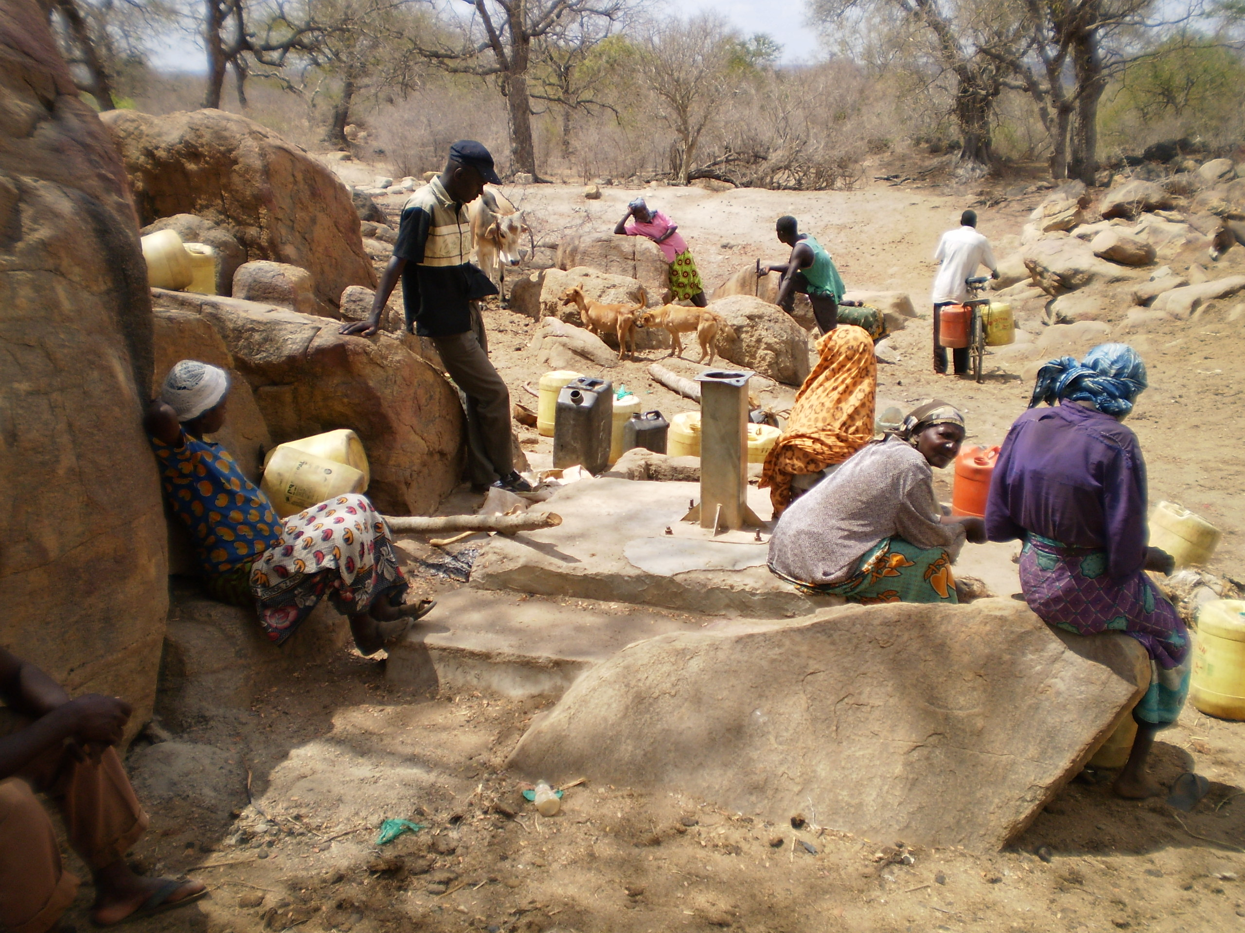
And what can go wrong

Slide 9
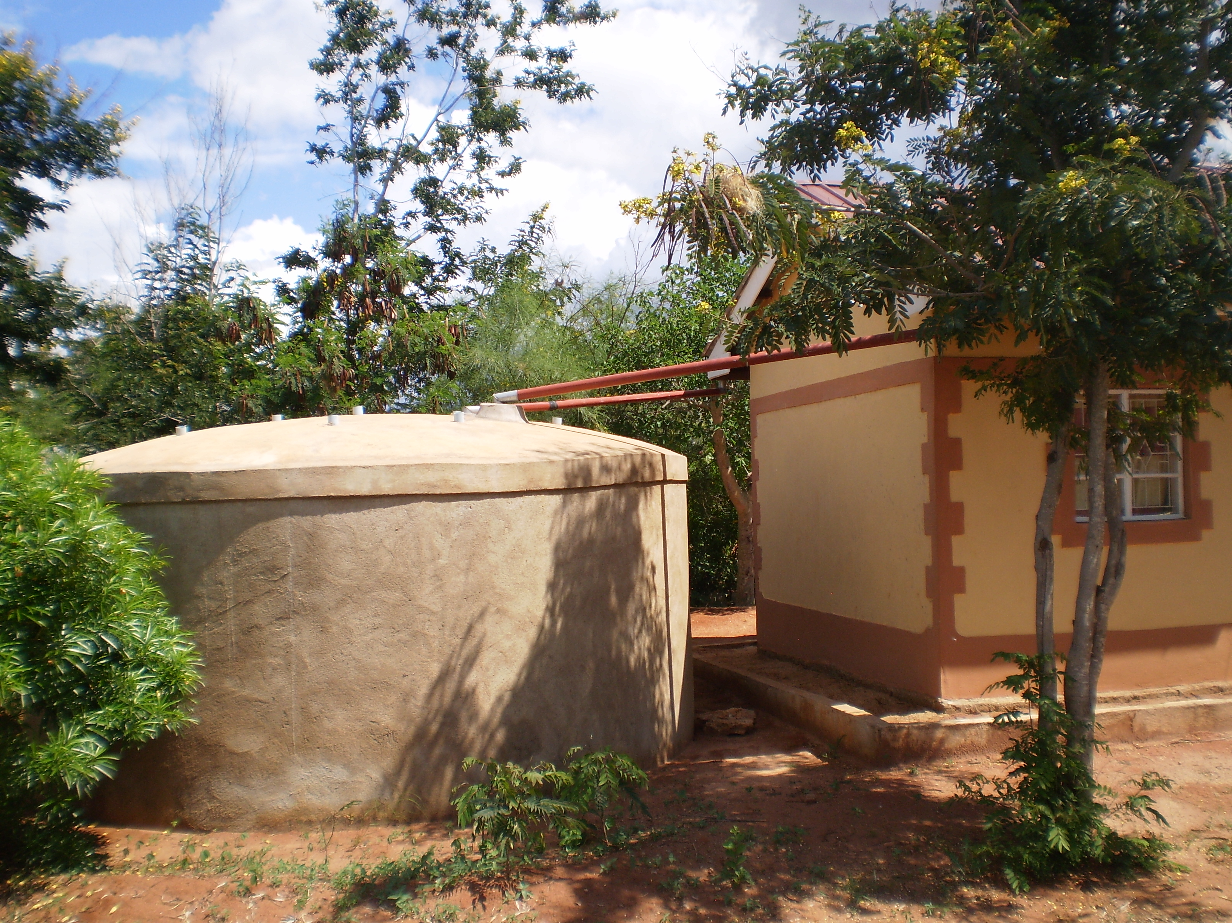
3R technologies in community development: simple, robust, environmentally sustainable
retention

Slide 10
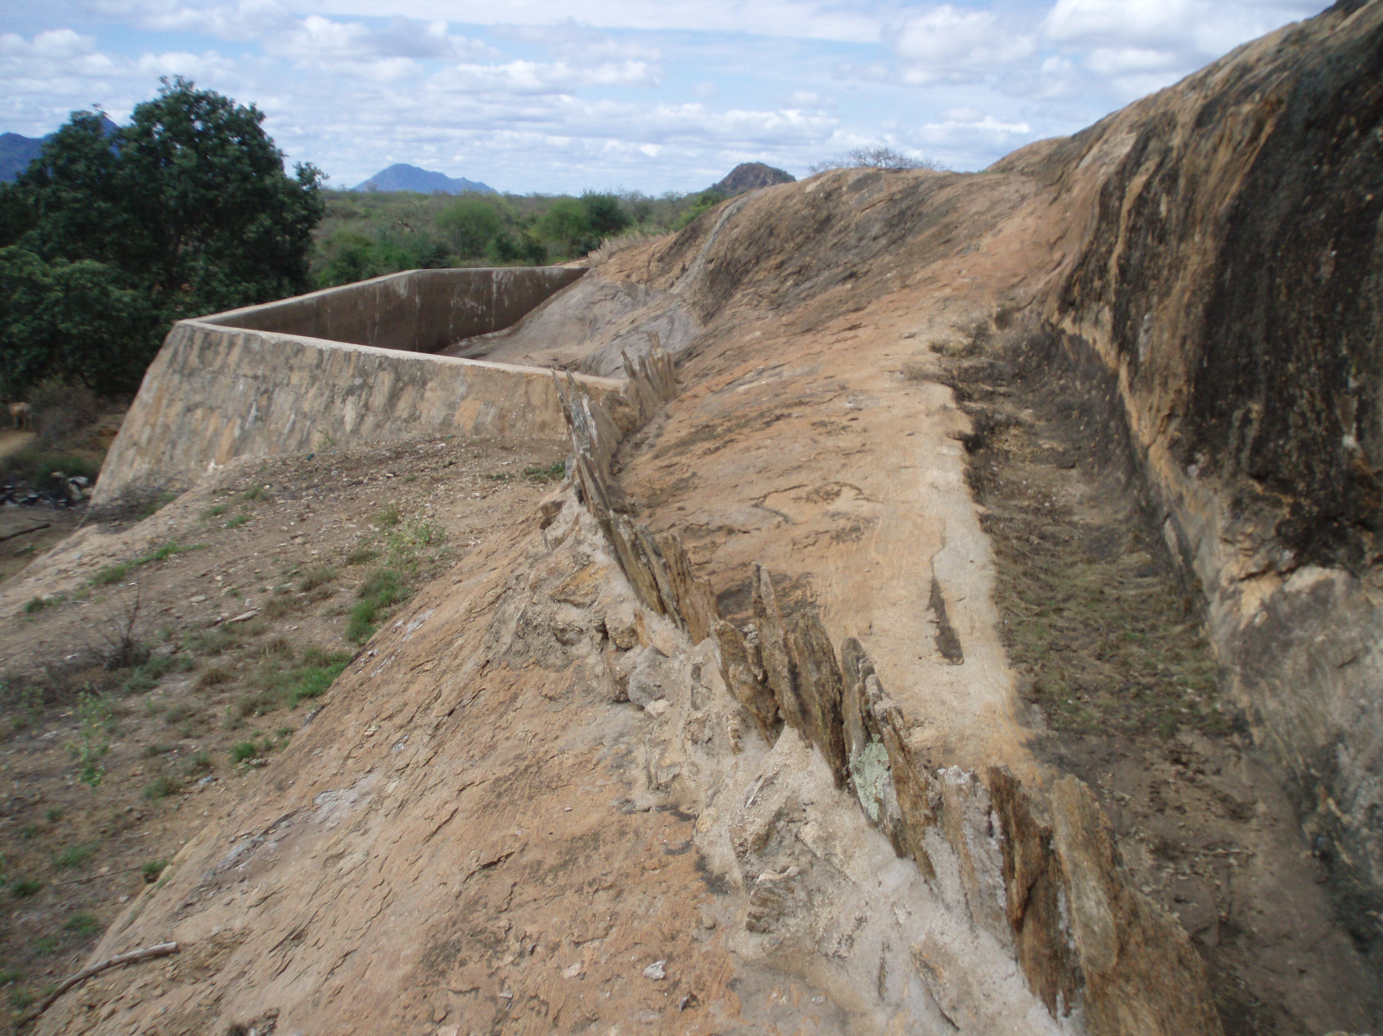
3R technologies in community development: simple, robust, environmentally sustainable
retention

Slide 11
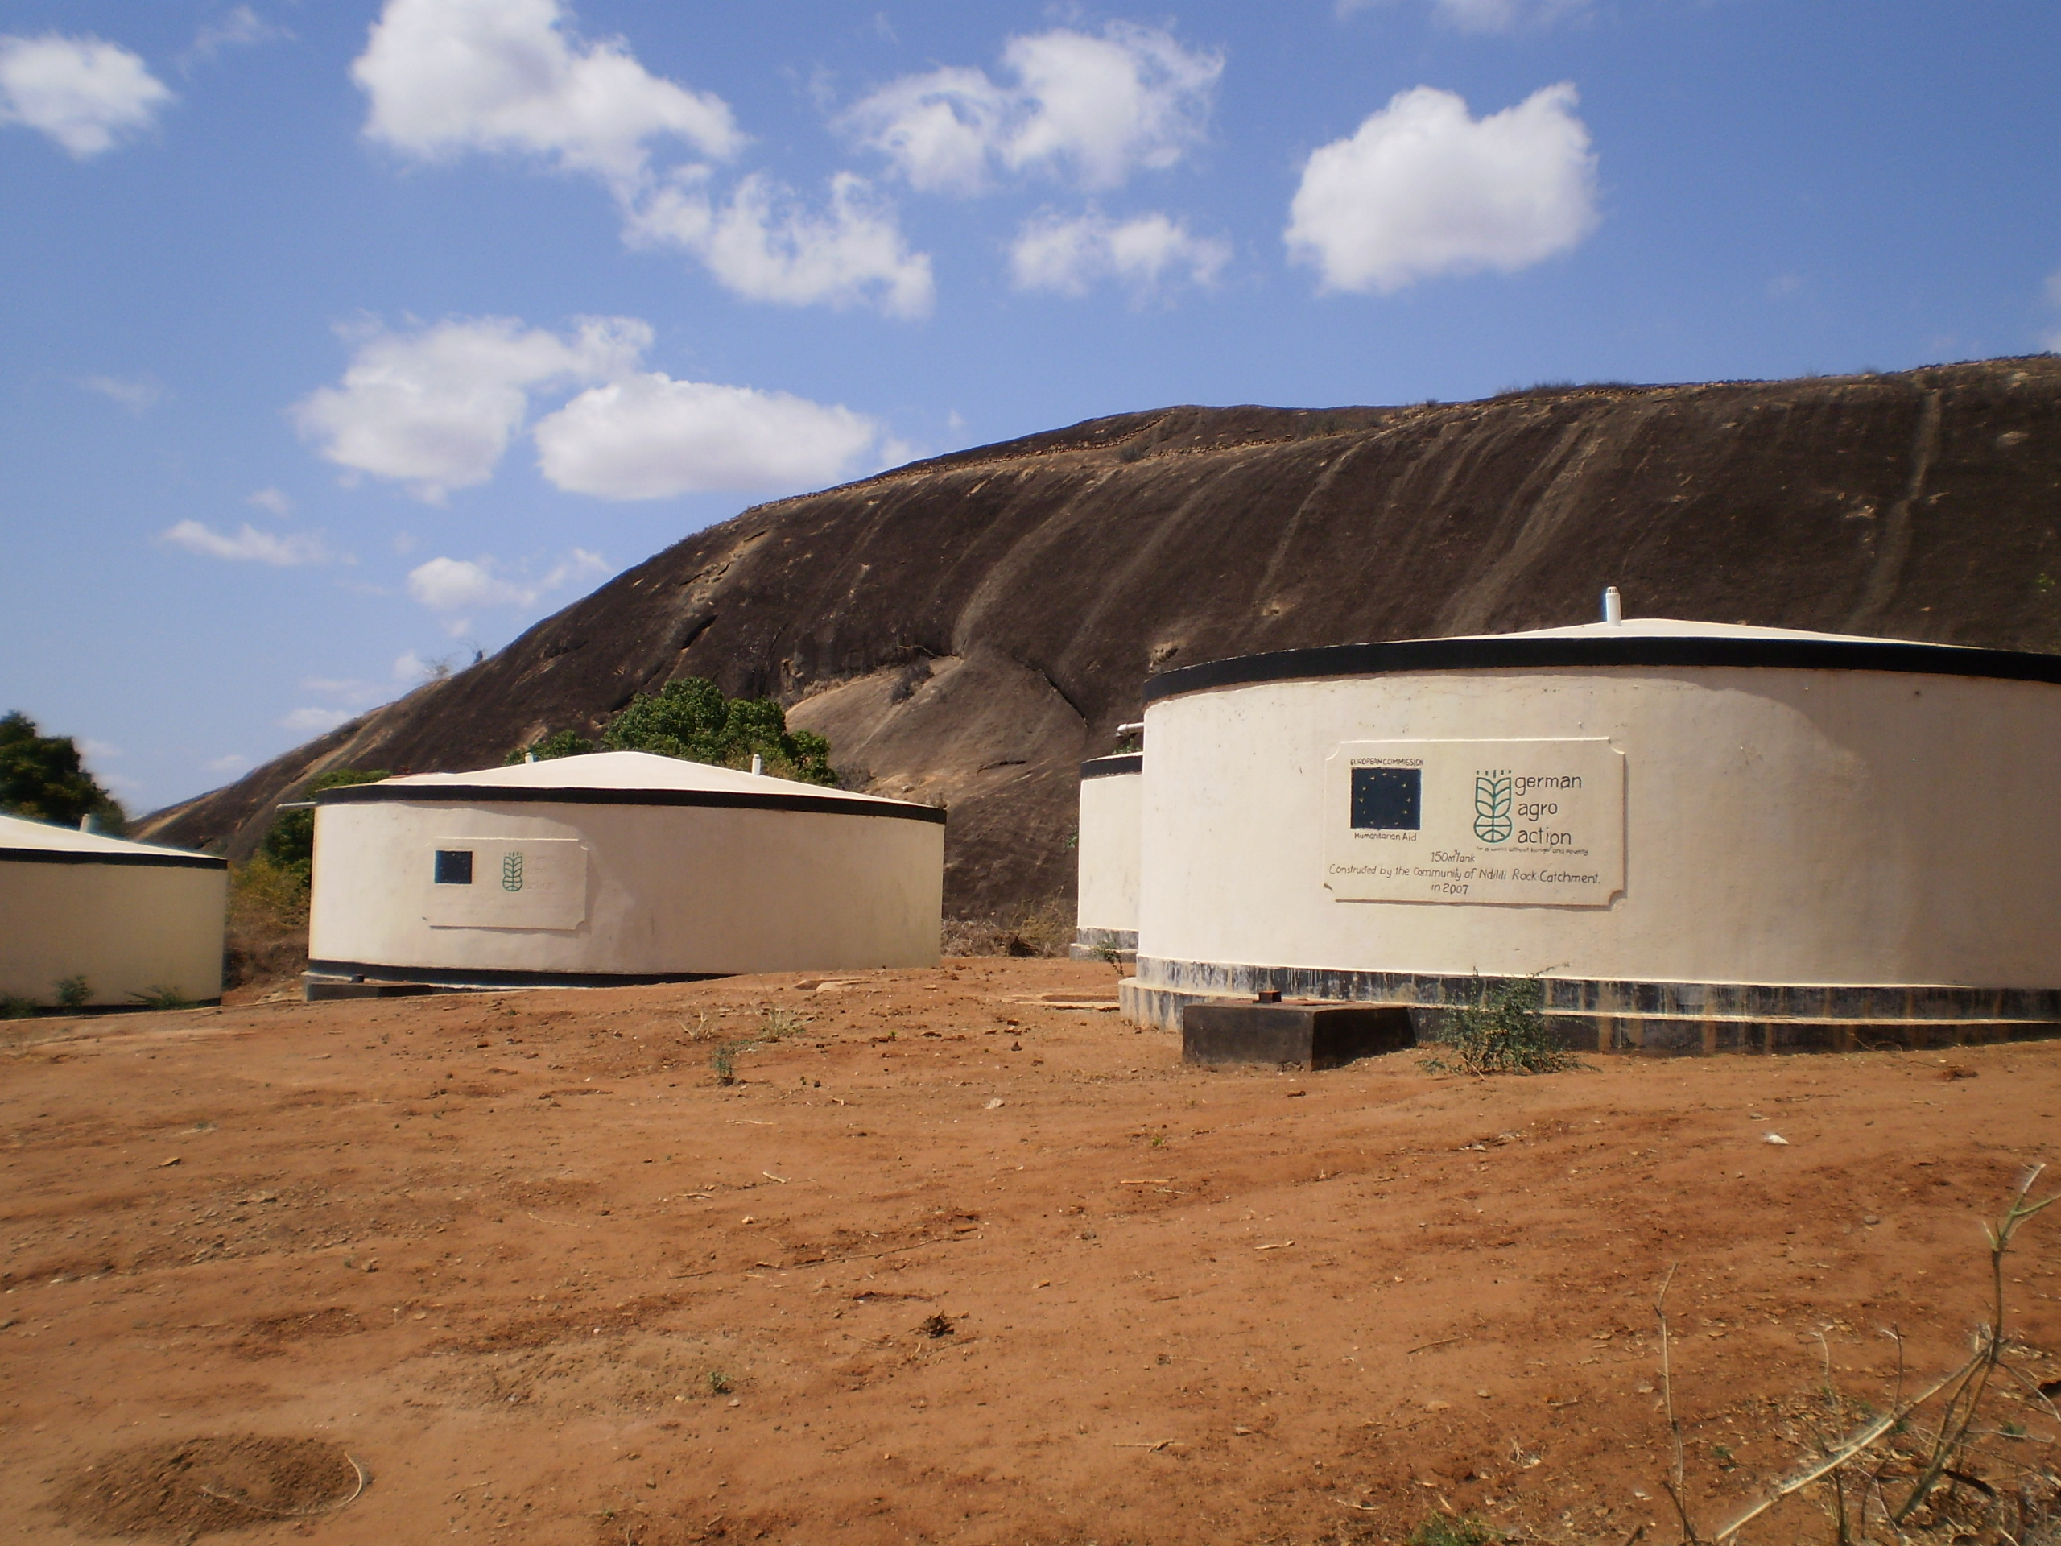
3R technologies in community development: simple, robust, environmentally sustainable
retention

Slide 12
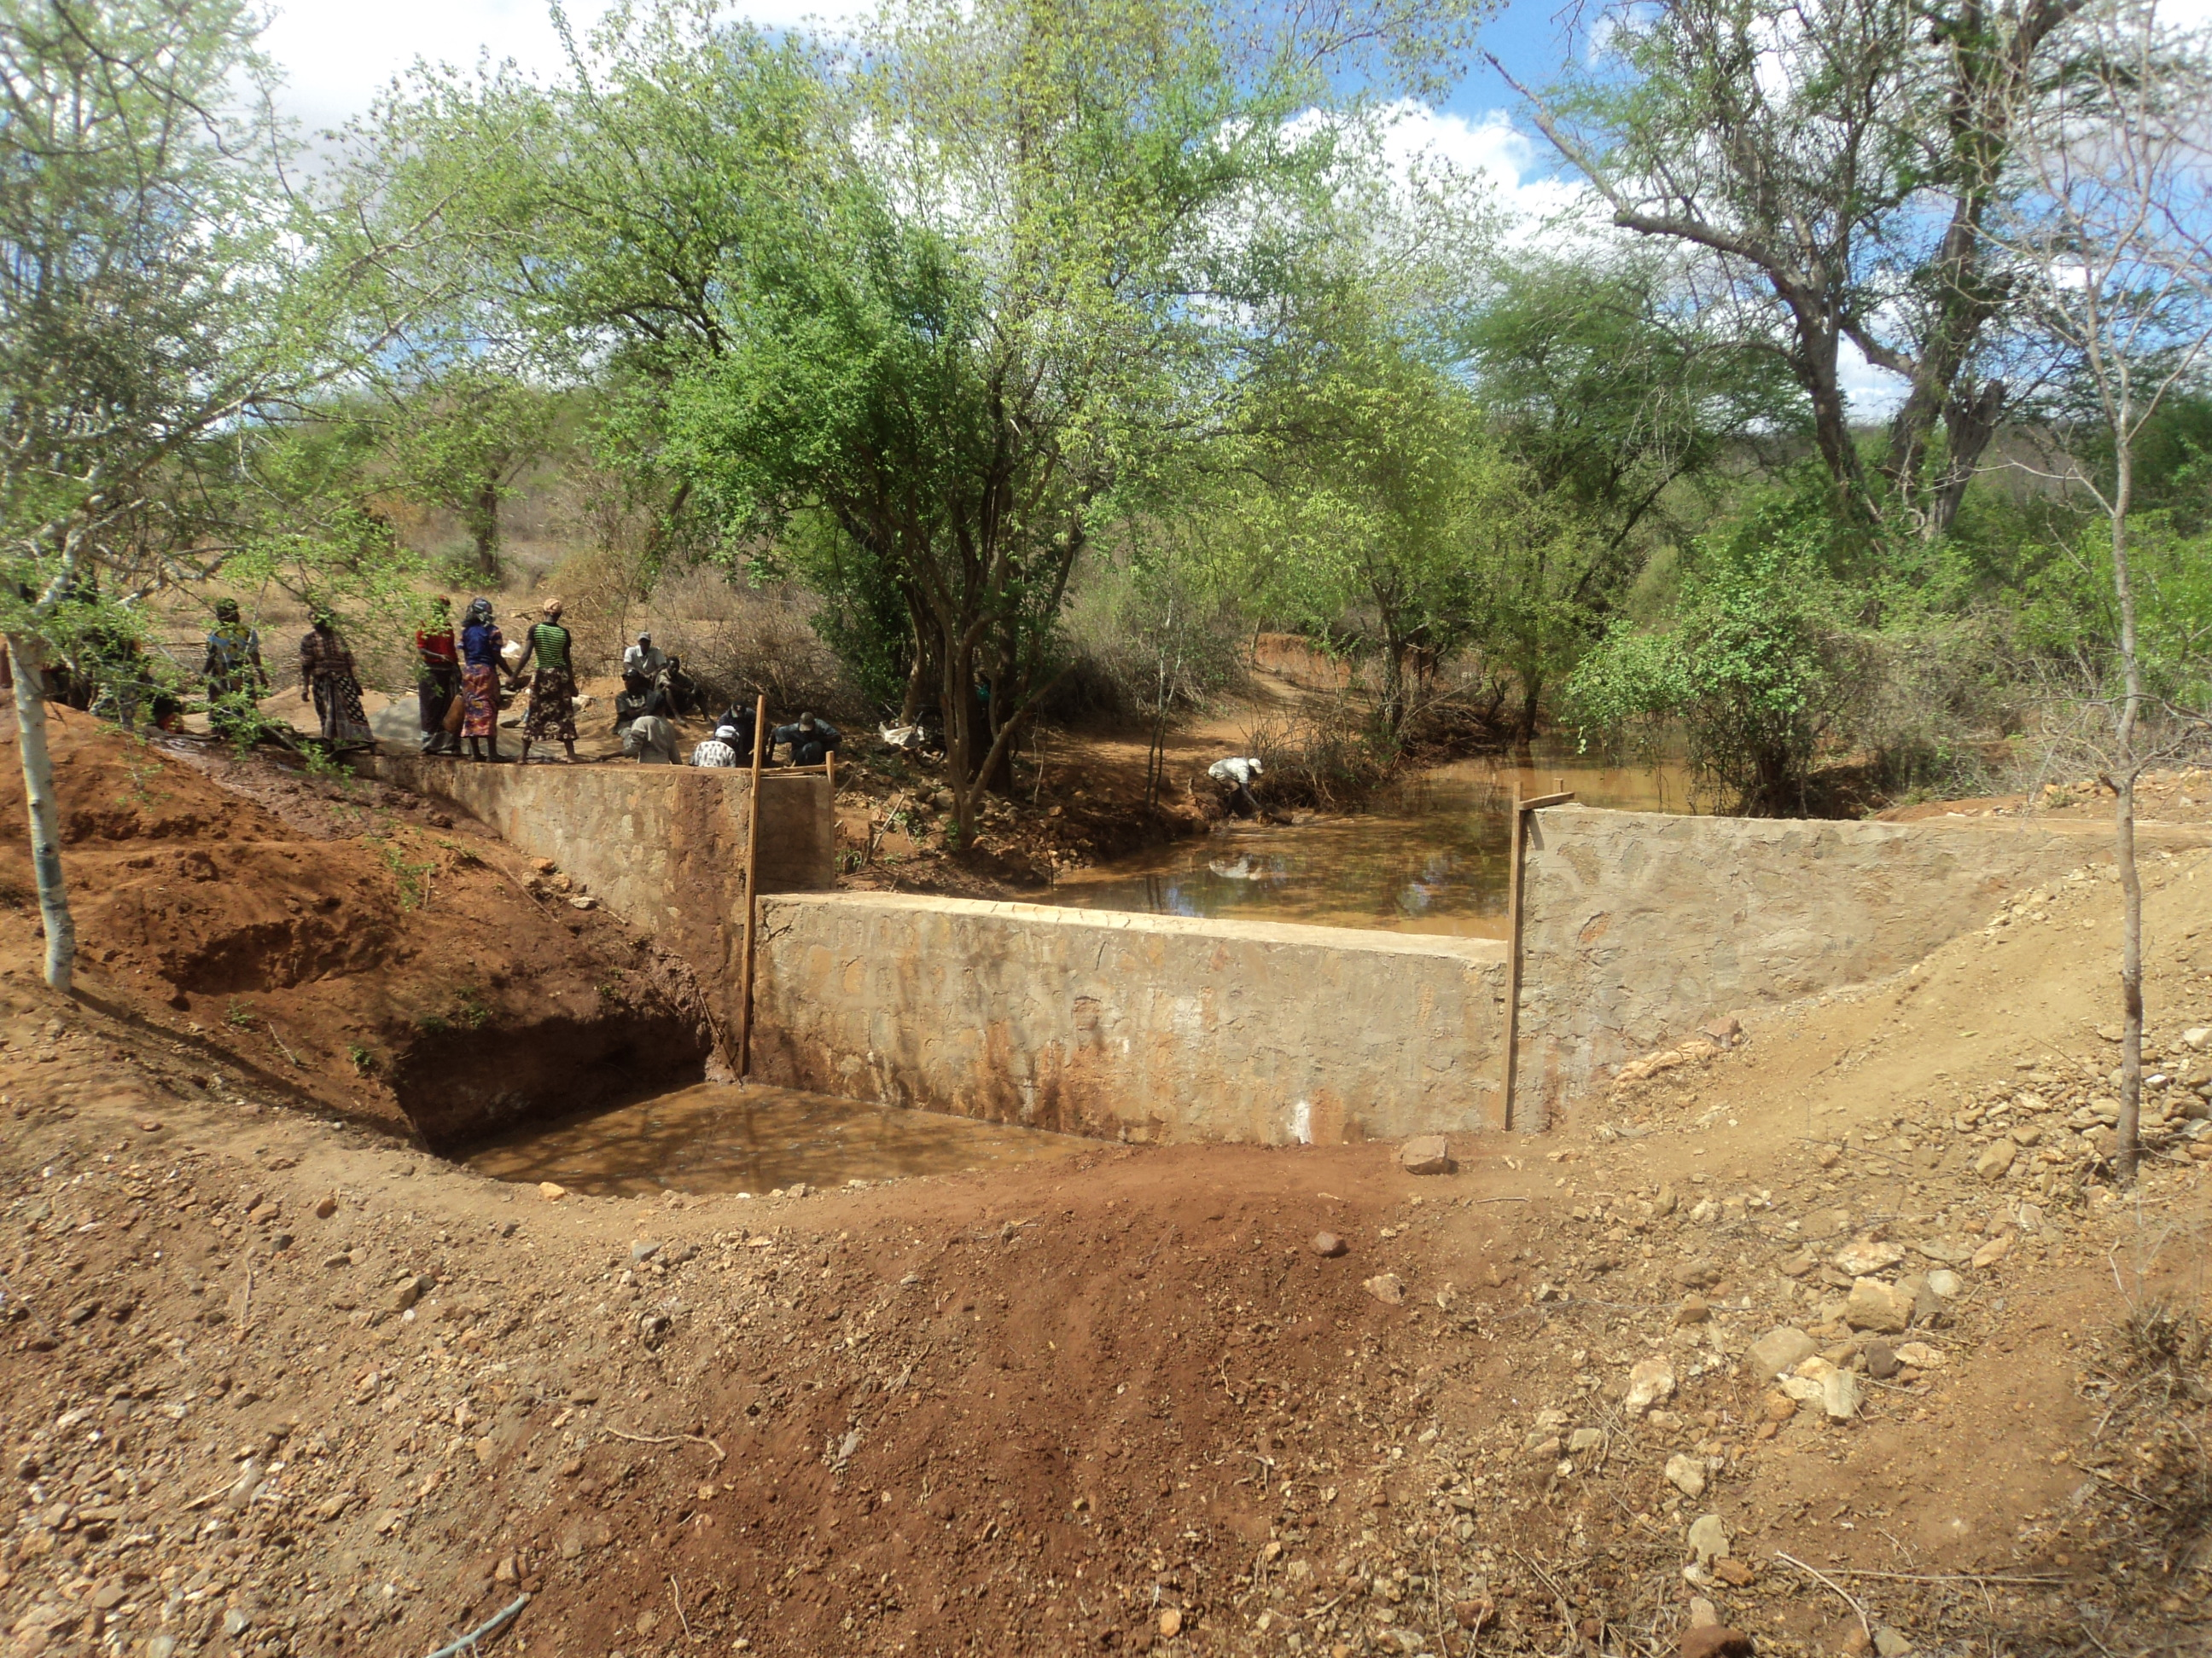
3R technologies in community development: simple, robust, environmentally sustainable
recharge

Slide 13
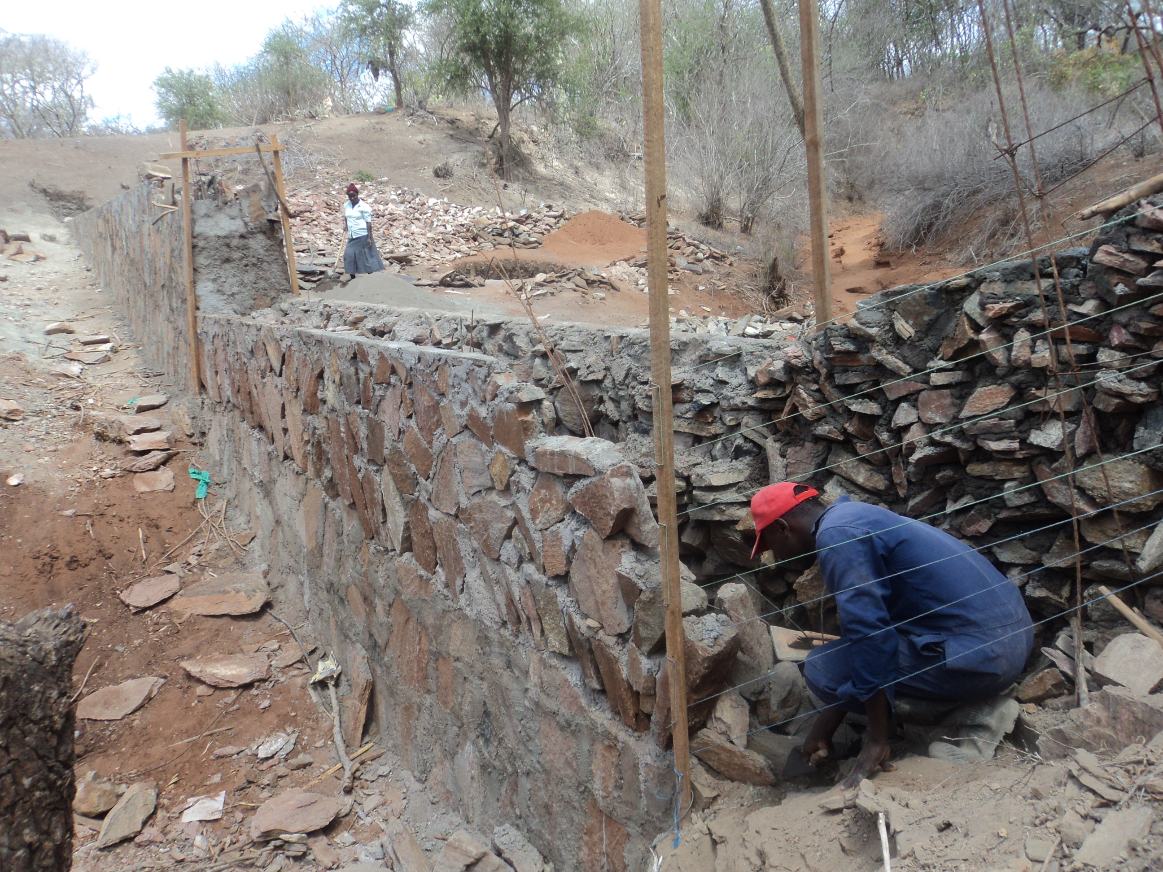
3R technologies in community development: simple, robust, environmentally sustainable
recharge

Slide 14
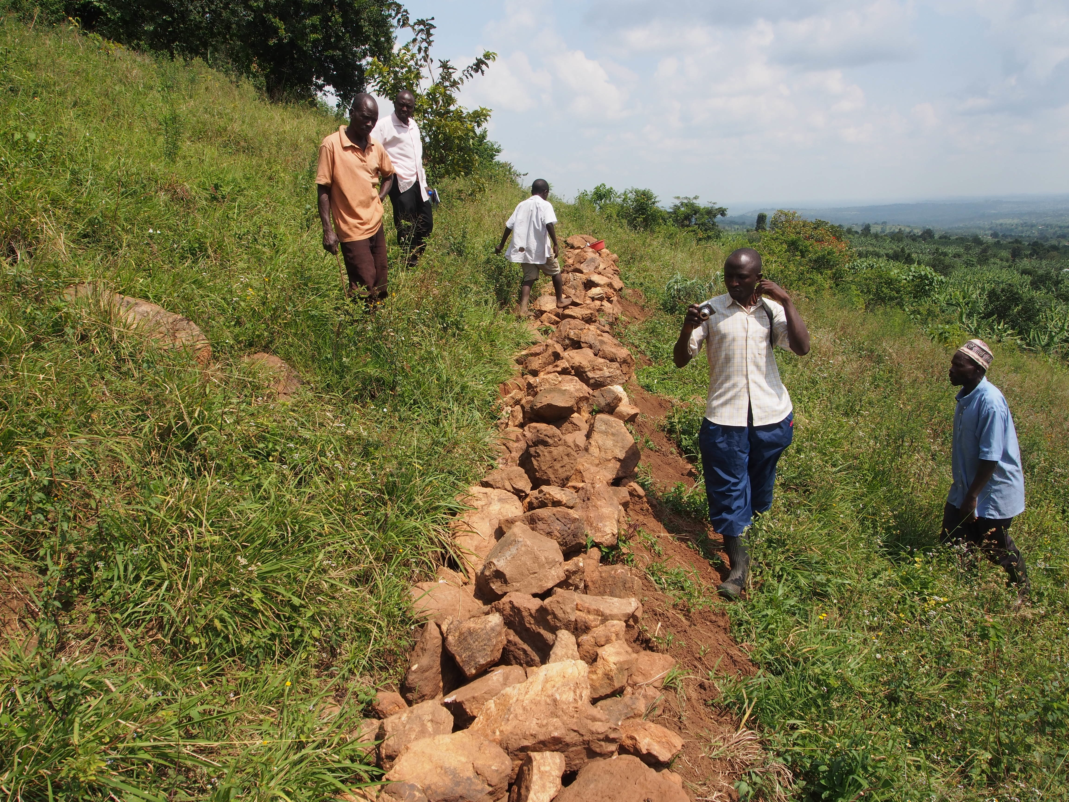
3R technologies in community development: simple, robust, environmentally sustainable
recharge

Slide 15
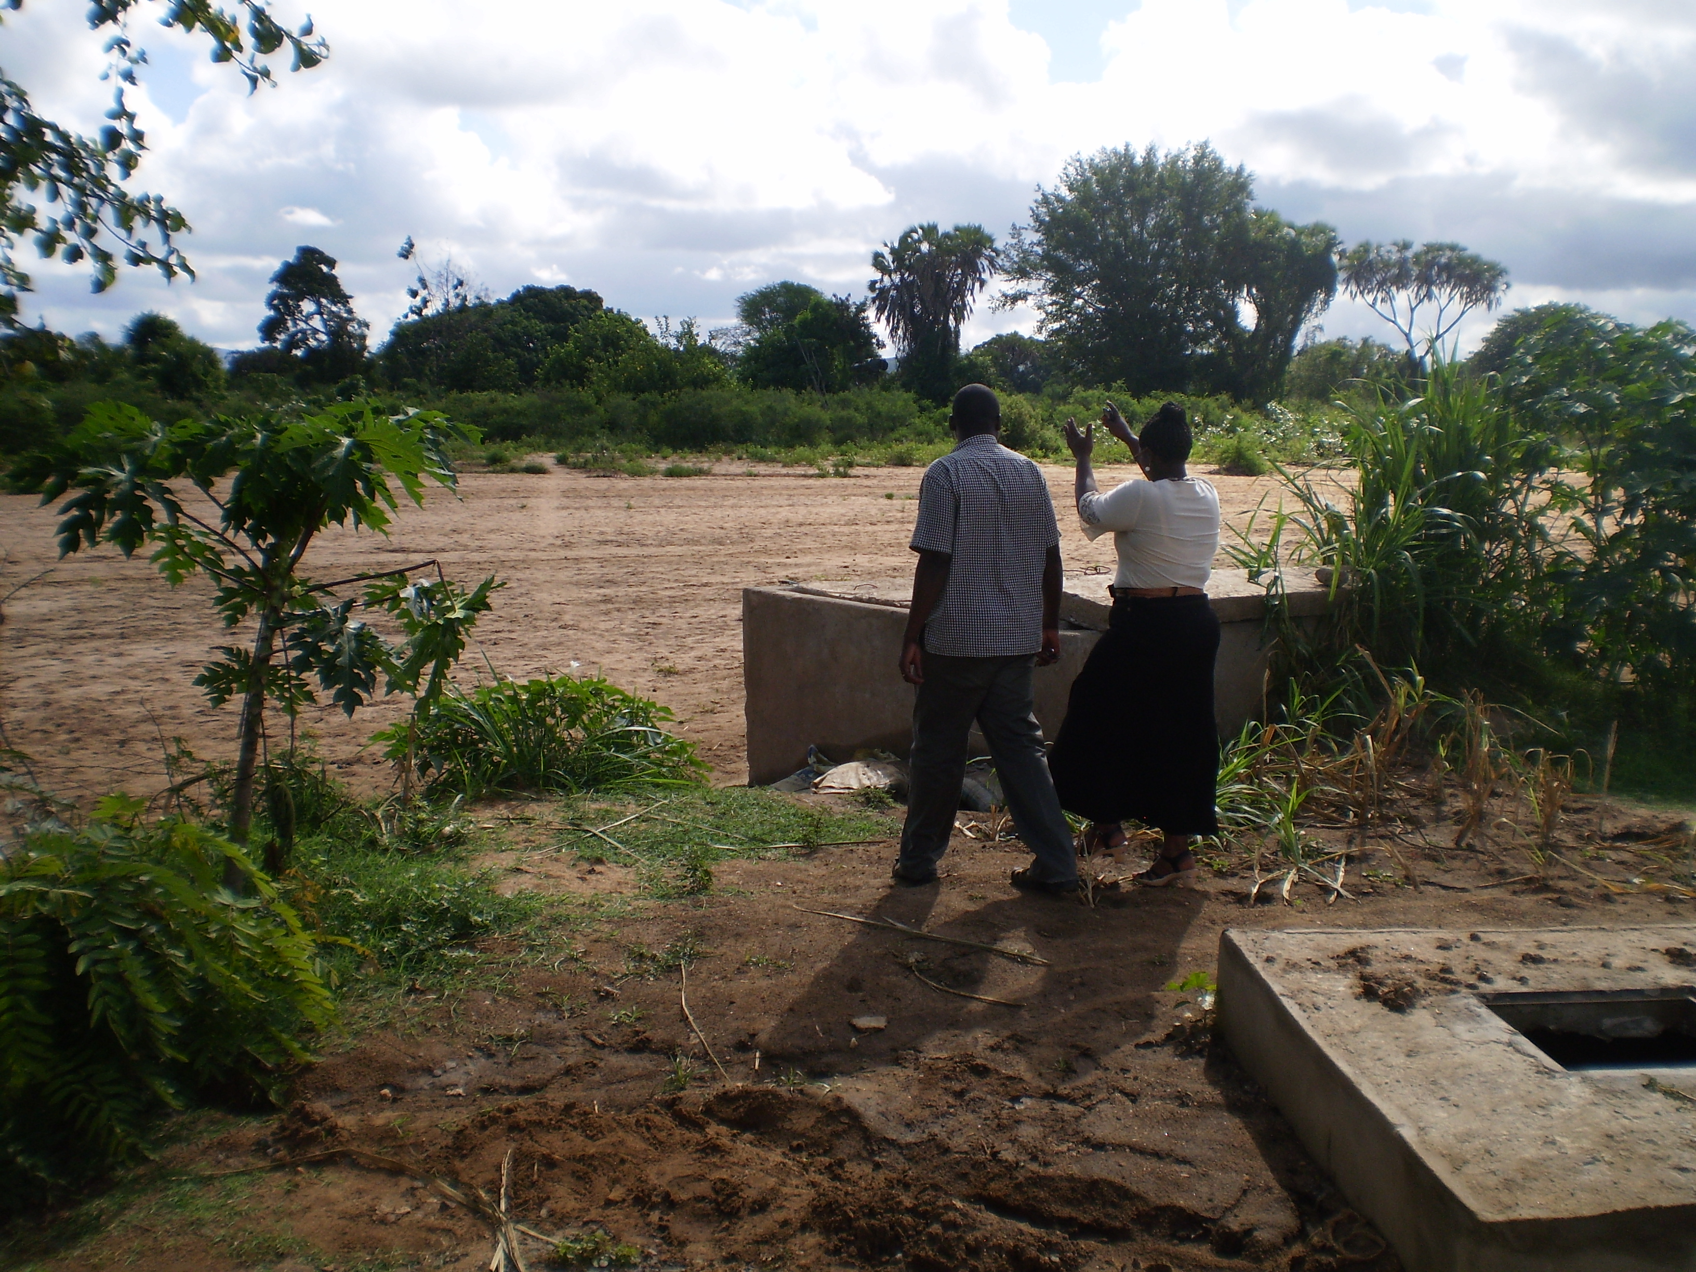
3R technologies in community development: simple, robust, environmentally sustainable
recharge

Slide 16
3R technologies in community development: simple, robust, environmentally sustainable
Reuse

Slide 17
3R technologies in community development: simple, robust, environmentally sustainable
Reuse

Slide 18
3R technologies in community development: simple, robust, environmentally sustainable
Reuse

Slide 19
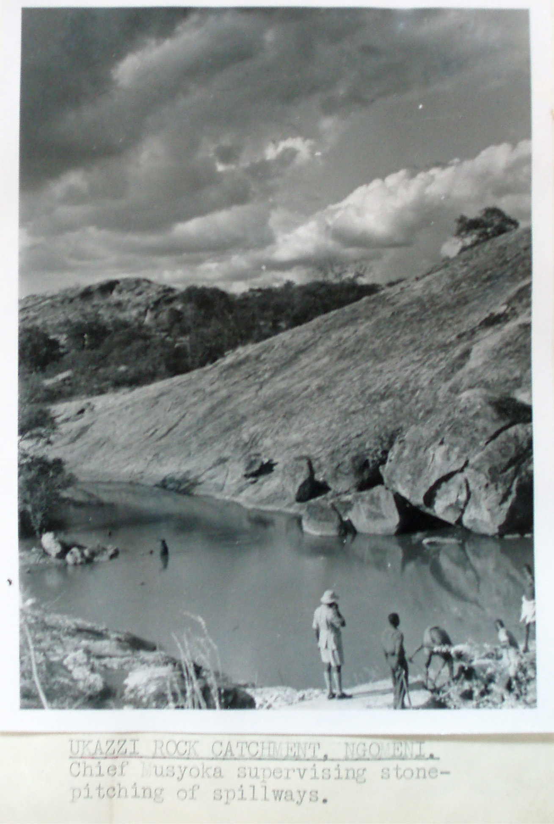
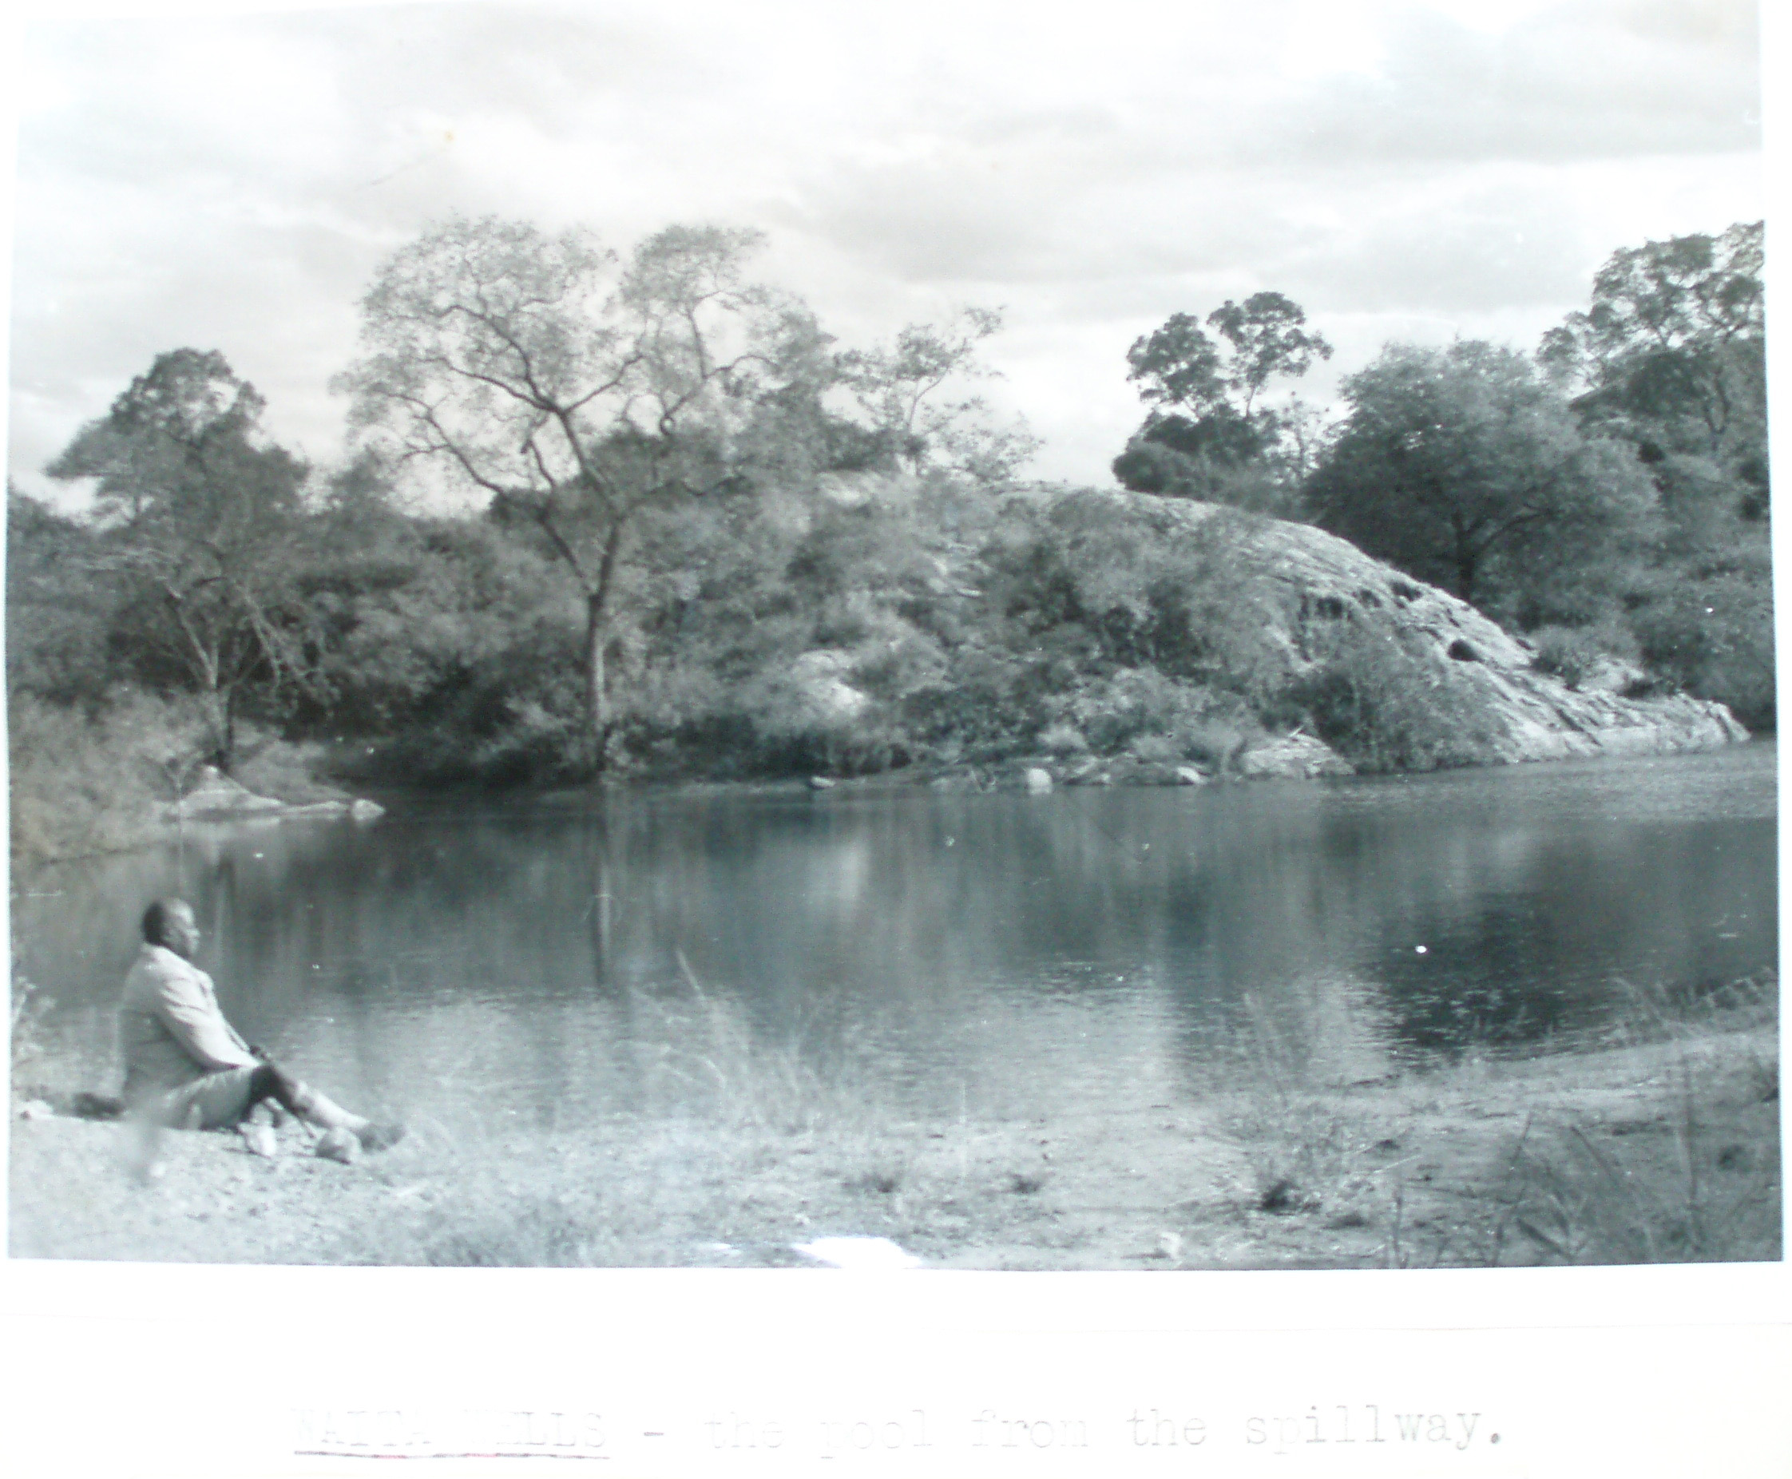
Whats new?
Kenya National Archives, Kitui district annual reports 1950 1956

Slide 20
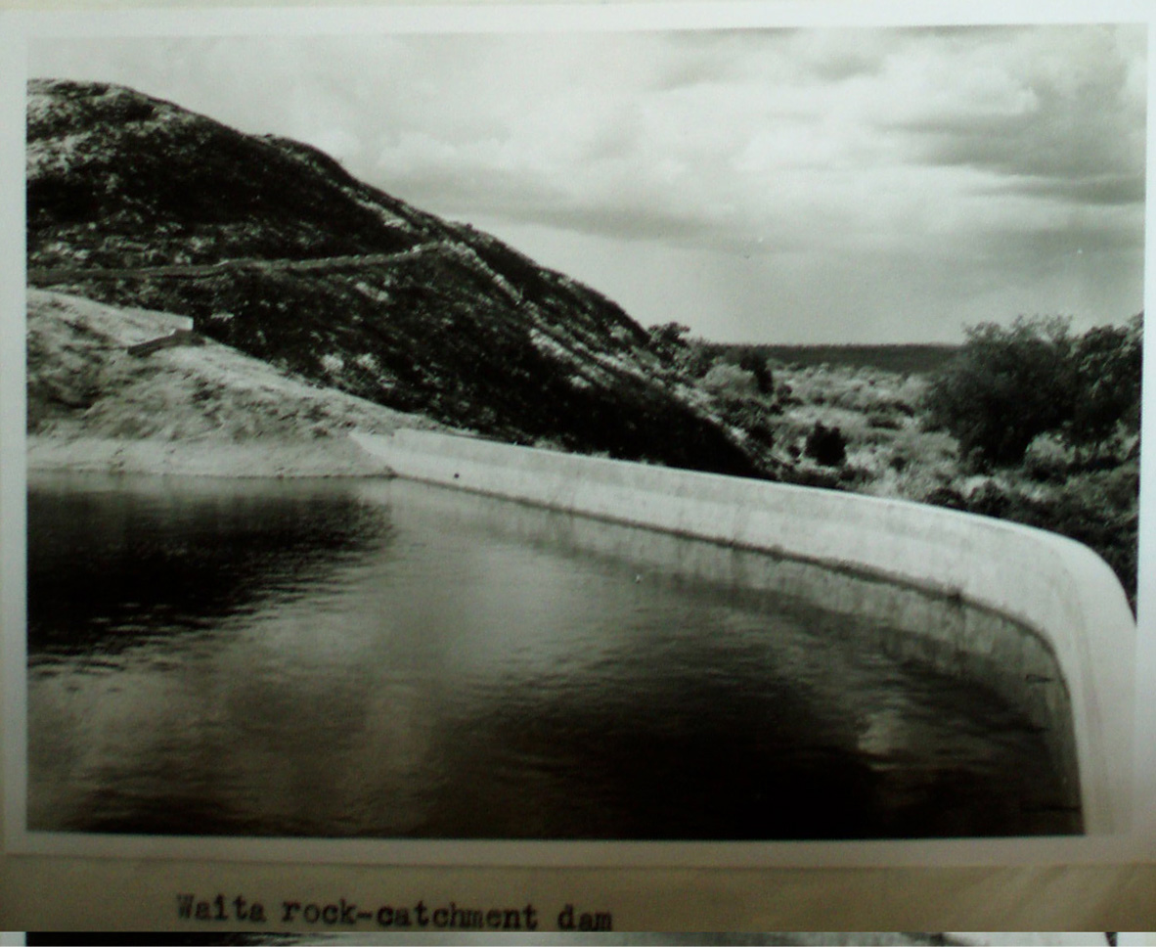
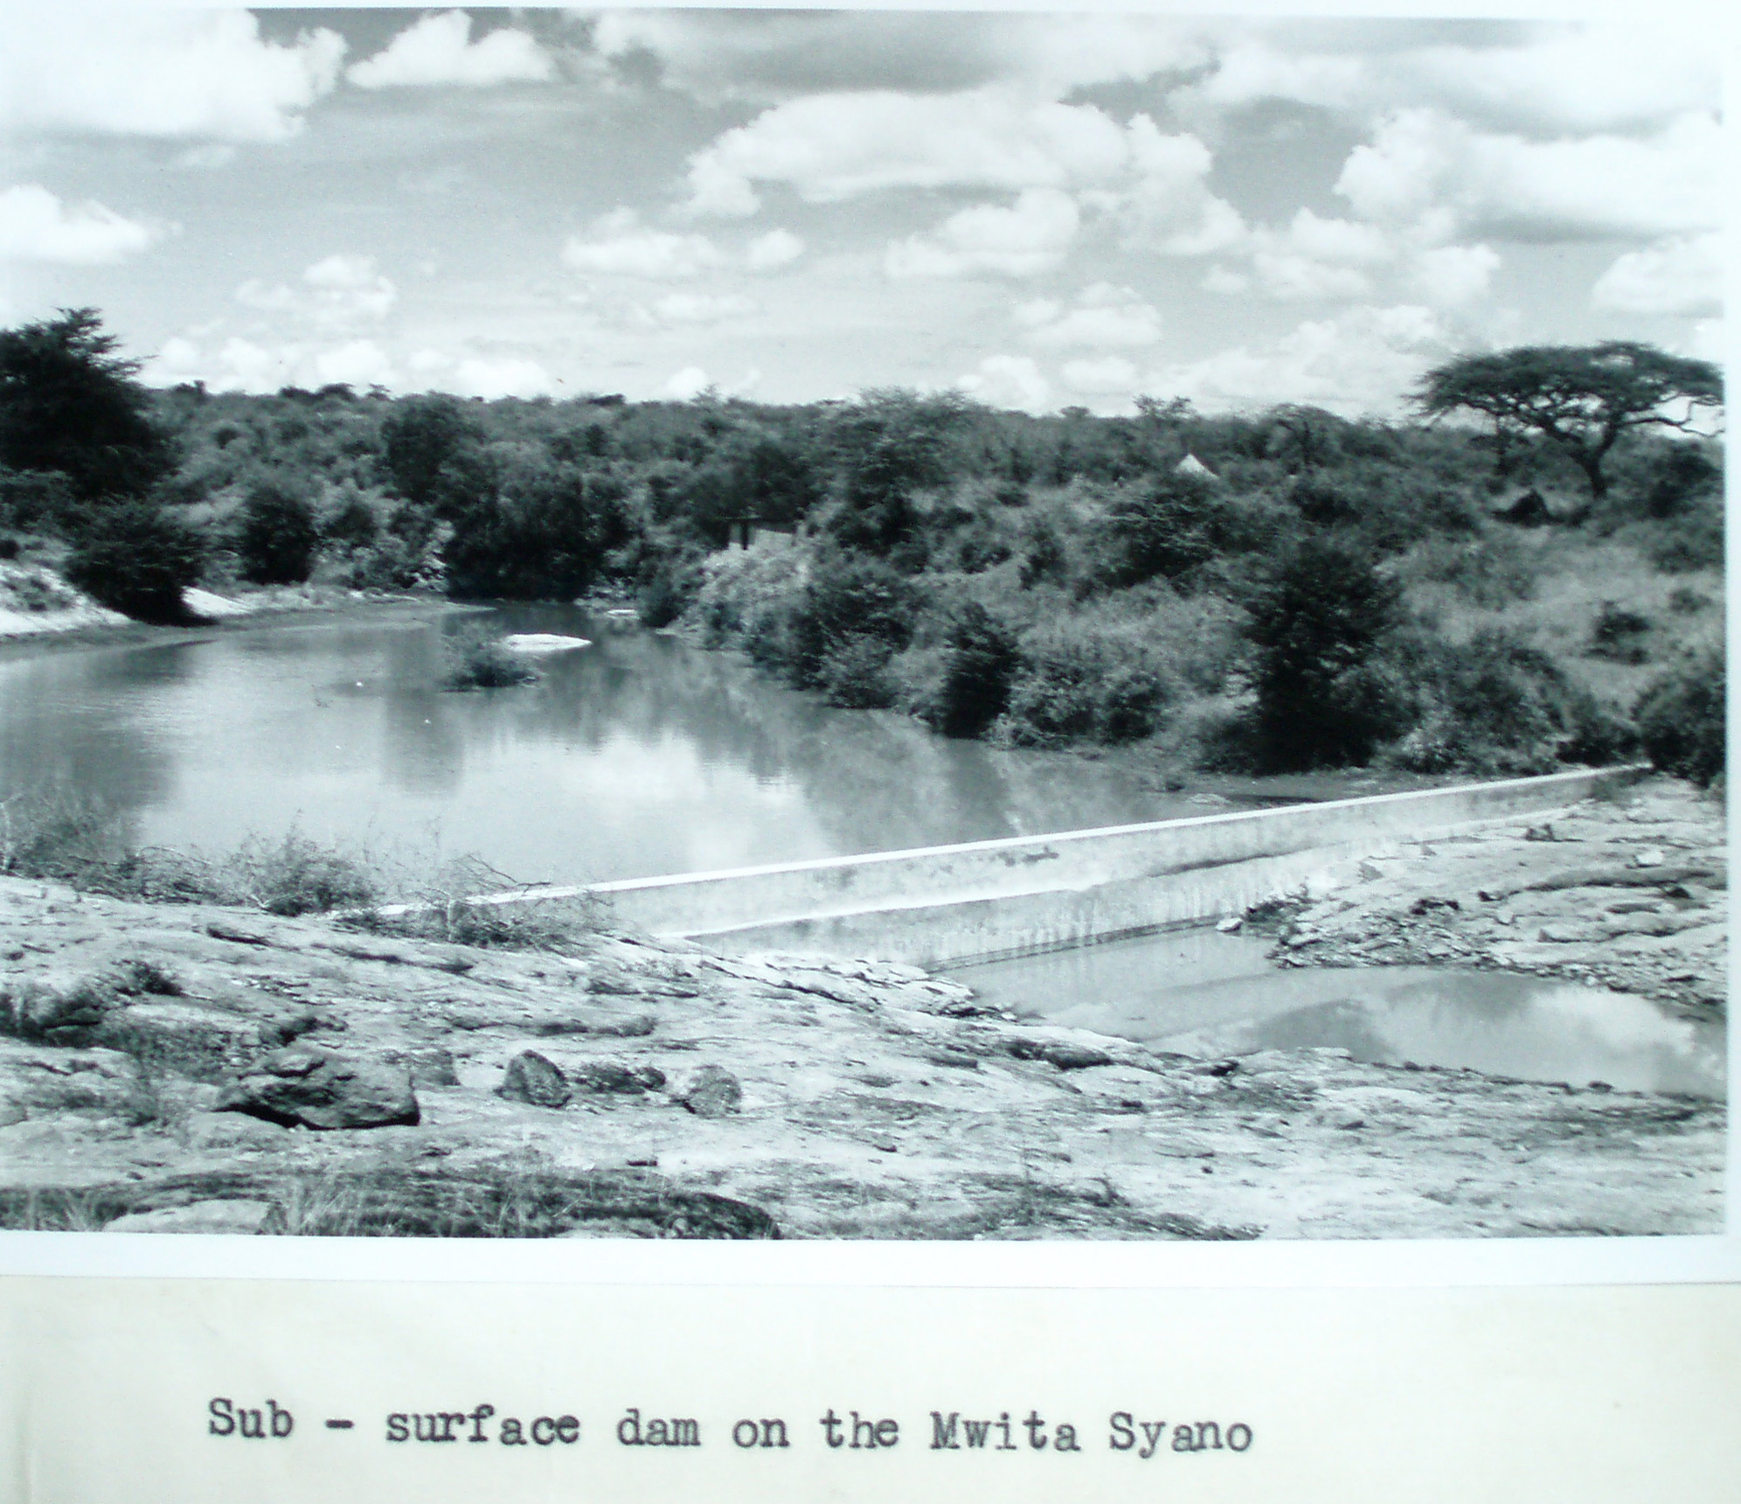
Talk about sustainability
Kenya National Archives, Kitui district annual reports 1950 1956

