Slide 1
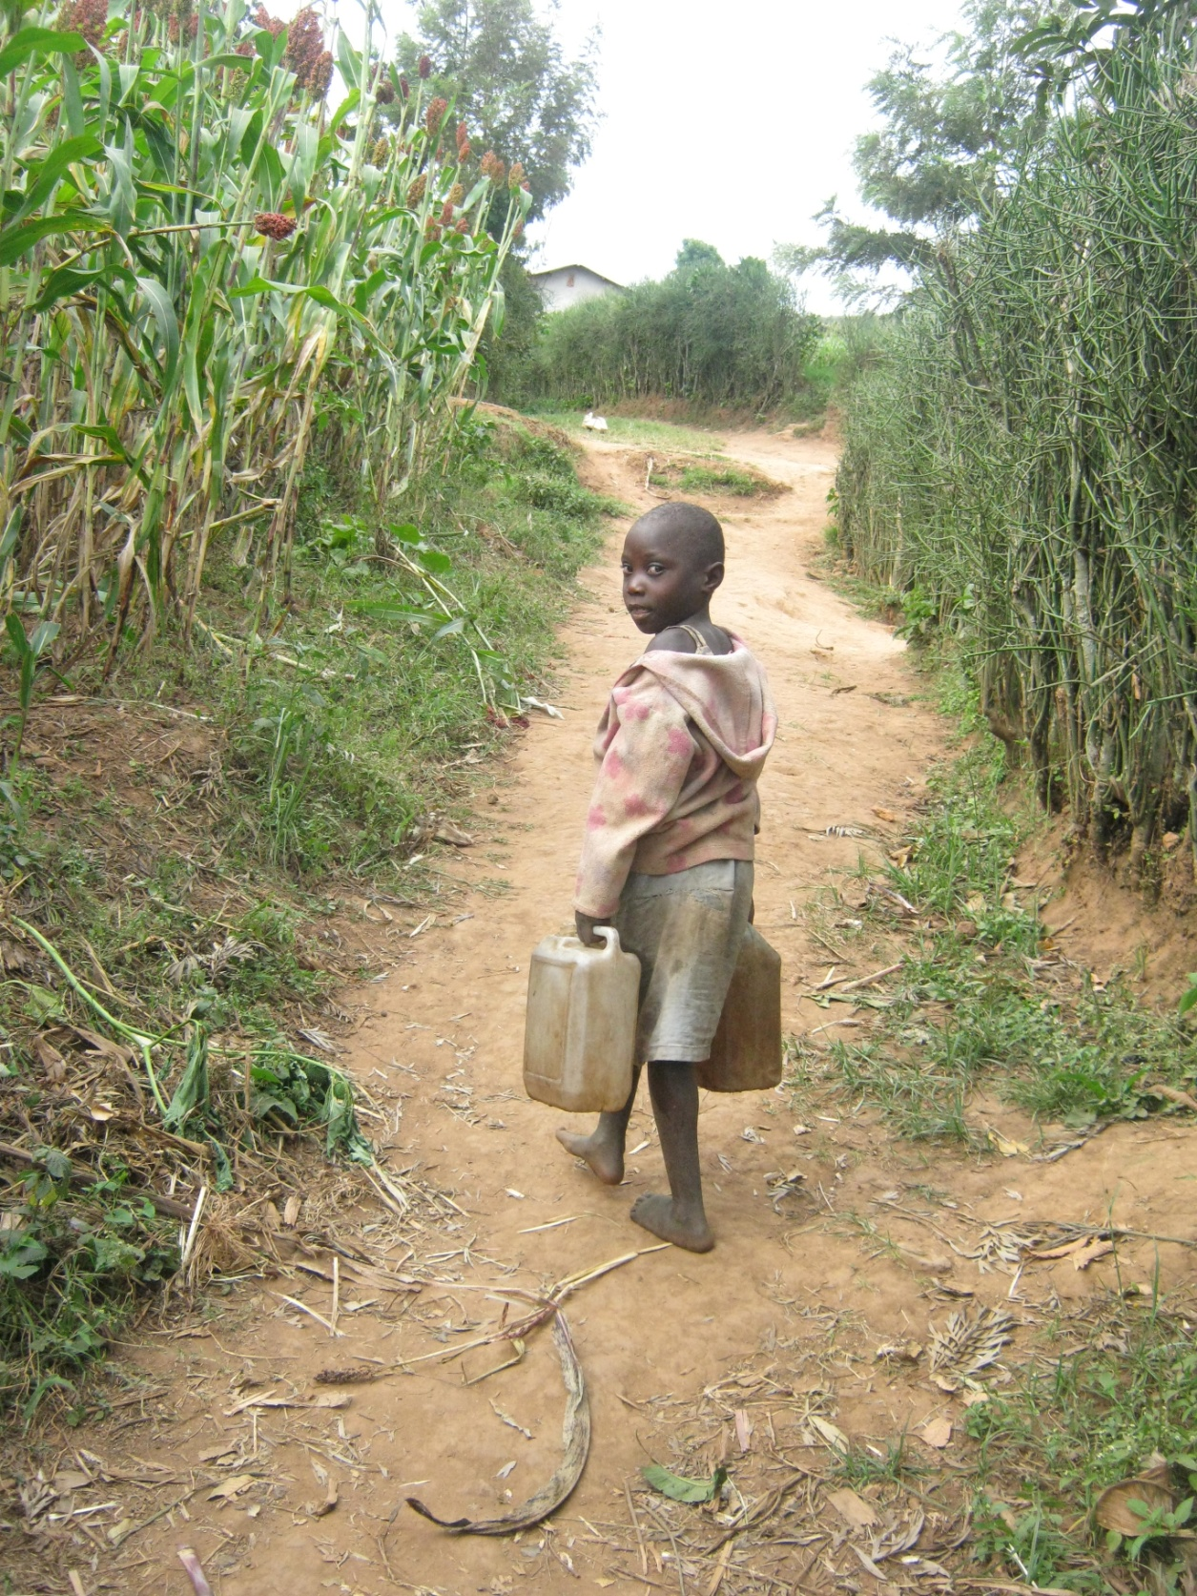
TheWaterChannel Webinar: Water and Sanitation in the Media: Relegated to the Side-lines?
By Fredrick Mugira

Slide 2
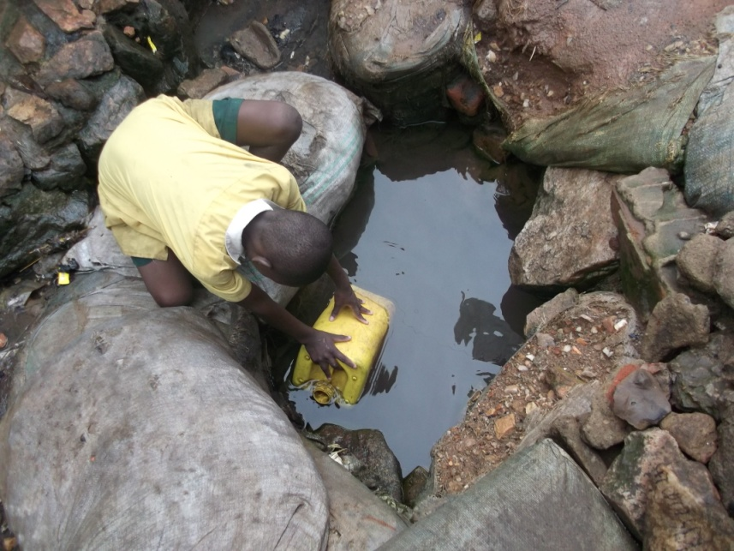
Current status
Insufficient WASH stories in African media
But coverage of these issues on the continent has increased over the last decade
WASH not a favourite field for most African journalists to report on.
WASH stories are buried deep inside most newspapers and magazines

Slide 3
examples of BAD wash stories
Lack local voices
Full of jargons
They use abstracts or confusing examples
They take a broad view and neglect paying attention to details.
They do not relate science to common experience
They lack humour
Do not empower
Lack research
Mere superficial interpretation of WASH issues
They are congested with several ideas and topics

Slide 4
End results
Stories are neglected by editors
Do not attract audience
Loss of sources whose facts are misrepresented in stories
Stories buried deep inside news papers.
Reporters neglect the beat saying it does not pay

Slide 5
Why WASH issues lack in African media
Lack of exposure to concepts in WASH systems among journalists
Misinformed and uninformed local communities
Corruption in WASH sector.
Lack of time and money
Concentration on promoting consumption of products.
Political interests of media coverage in Africa
Lack of interests amongst Africans journalists
The media’s short attention span
Complex, boring and hard to understand nature of some WASH issues
Competition from sensational stories which are cheap to cover and attract readers readily

Slide 6
Characteristics of good WASH stories
Provide information on key developments in the WASH sector in a way that gives them meaning
Use simple and common examples
Give a voice to those marginalized from public debate and decision making
Report responsibly towards welfare and interests of society
Define hard terms
Support commonly agreed codes of conduct
Scrutinize and expose malpractice in WASH sector
Use creative and interesting language
Inform audience issues that affect them personally.
Empower local people with knowledge to demand for the deserved services.
Let people tell their own stories

Slide 8
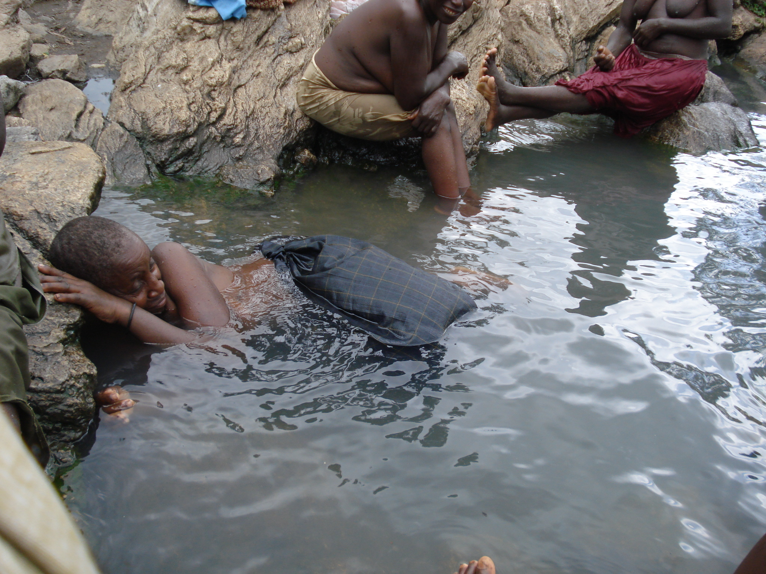

Slide 9
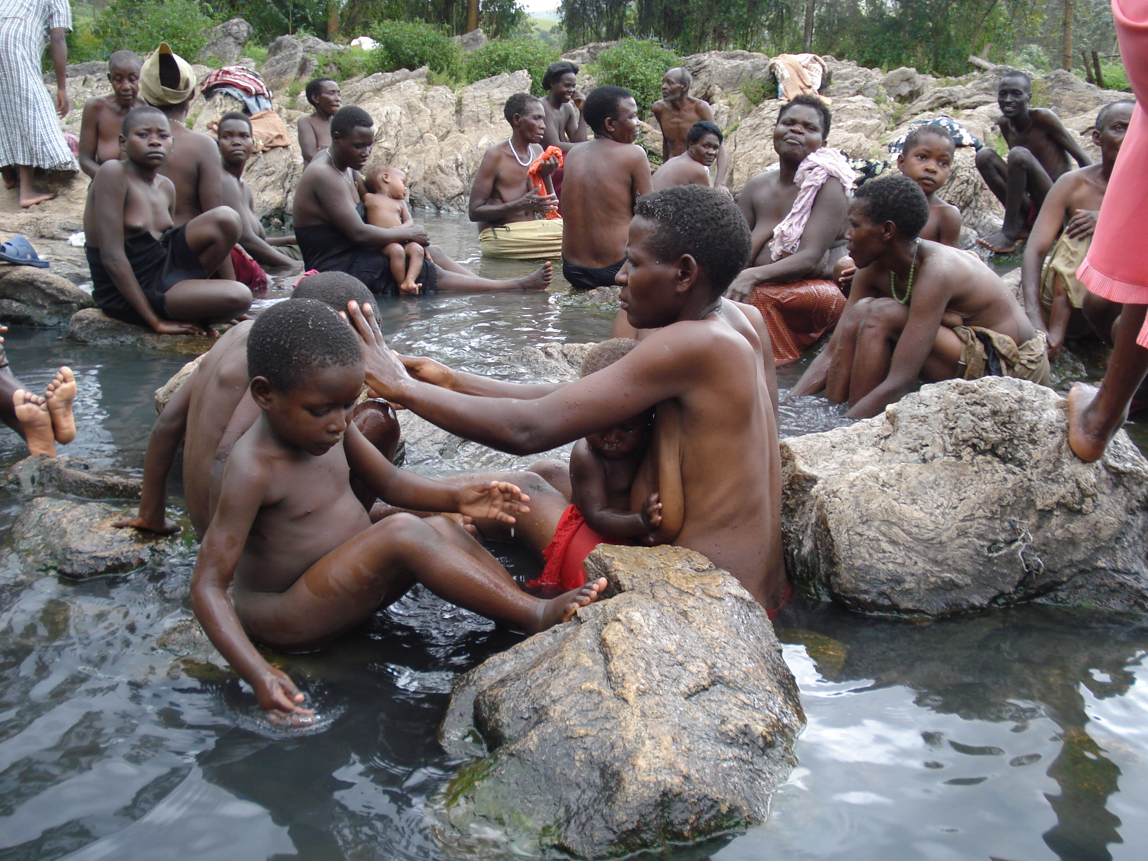

Slide 10
Journalists reporting WASH
Some African journalists are defying media preferences, and have formed social media networks and platforms to enhance WASH awareness
Eg. Water Journalist Africa (WJA)- journalists addresses topics on water and sanitation.
Established in March 2011 during UN Water Day in Cape Town, South Africa.
Network now has over 500 active members
Membership is free
Are now using their newsletter WaterSan Perspective www.waterjournalistsafrica.wordpress.com to facilitate communication between the public, policy-makers and technocrats on the continent.
Posts do not impact the online community, but make waves in offline Africa through information diffusion
95,210 views this morning

Slide 11
Examples of WASH stories
Malawi: Water User Associations (WUAs) Bear Fruits: By George Mhango http://waterjournalistsafrica.wordpress.com/2014/09/12/malawi-wonders-of-water-user-associations-wuas-in-malawi/
UGANDA: SHADOWS IN THE WATER. By Fredrick Mugira. https://waterjournalistsafrica.wordpress.com/tag/lake-mburo-national-park/
Cameroon: Marine Litter Threatens Aquatic Life and Human Health. By Edith Achamukong http://waterjournalistsafrica.wordpress.com/2014/07/18/cameroon-marine-litter-threatens-aquatic-life-and-human-health/
Uganda: Pictures to Tell the Dilemma: Adah and Shakira’s Story. By Fredrick Mugira. https://waterjournalistsafrica.wordpress.com/2011/06/24/uganda-pictures-to-tell-the-dilemma-adah-and-shakira%E2%80%99s-story/

Slide 12
WASH stories that need to be reported most urgently
Integrity in the WASH sector
Prioritization of Water, Sanitation and Hygiene issues in development agenda
Effects of climate change on WASH sector

Slide 13
challenges of specializing in WASH journalism
High competition from others beats
Corrupt and uncooperative officials
Lack of support from editors and media managers
Constant research
Media shy experts/ scientists
The media’s short attention span
Lack of support from community leaders who want to side with their voters
Scientific terms not simplified by scientists
Poor pay due to few story count at the end of the month
Getting too close to the story
Difficult to balance because of the closed nature of some African cultures

Slide 14
Suggested solutions
Training of journalists to specialize in WASH
Water integrity advocacy and campaigns
Facilitation of journalists
Create simple WASH language that is accepted internationally to help break WASH jargons
Editors and media managers should come up with a policy of publishing or airing a given number of water stories per news bulletin or newspaper issue.

Slide 15
End
Thank You So Much

